Slide 1
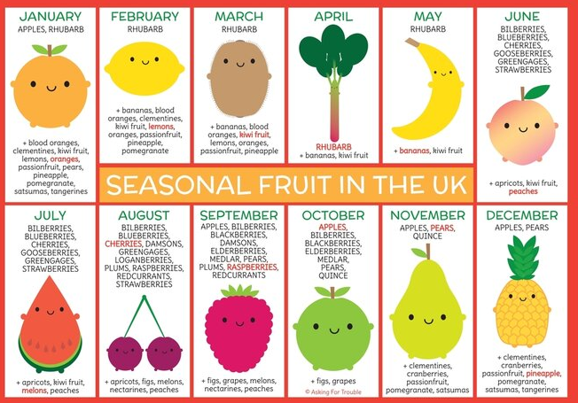
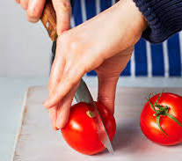
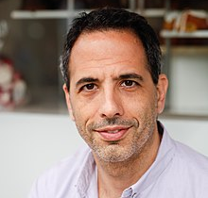
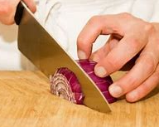
Design Technology- Y6 - Food - Celebrating Culture and Seasonality
Chef
Yotam Assaf
bridge grip
claw grip
Yotam Ottolenghi is an Israeli-born British chef, restaurateur, and food writer. He is the co-owner of seven delis and restaurants in London, and the author of several bestselling cookery books.
origin: the point or place from which something comes
seasonality: something that changes according to the time of the year
ingredients - any of the foods or substances that are combined to make a particular dish.
recipe: a set of instructions for preparing a particular dish, including a list of the ingredients required

Slide 2
Design Technology- Y6 - Food - Celebrating Culture and Seasonality
Chef
Yotam Assaf
bridge grip
claw grip
Yotam Ottolenghi is an Israeli-born British chef, restaurateur, and food writer. He is the co-owner of seven delis and restaurants in London, and the author of several bestselling cookery books.
origin: the point or place from which something comes
seasonality: something that changes according to the time of the year
ingredients - any of the foods or substances that are combined to make a particular dish.
recipe: a set of instructions for preparing a particular dish, including a list of the ingredients required

