Slide 1

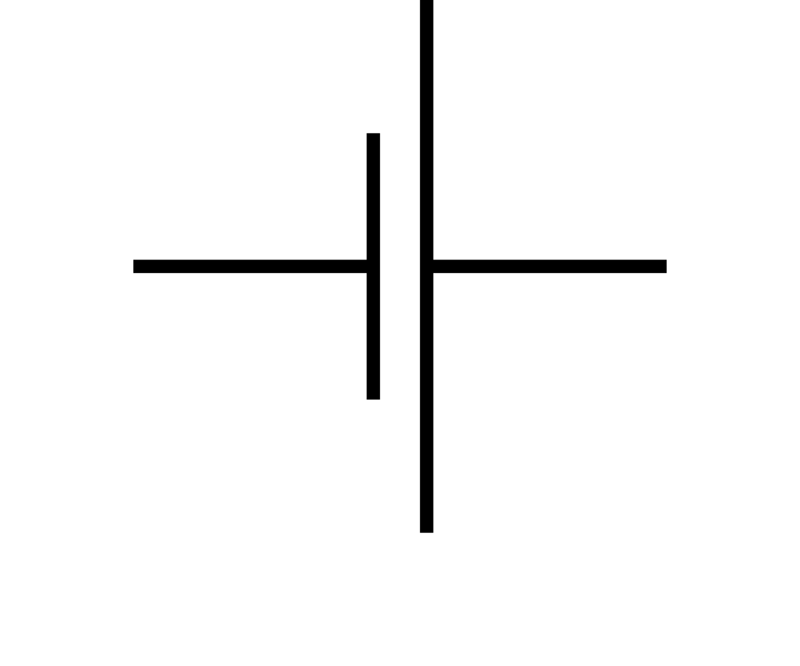
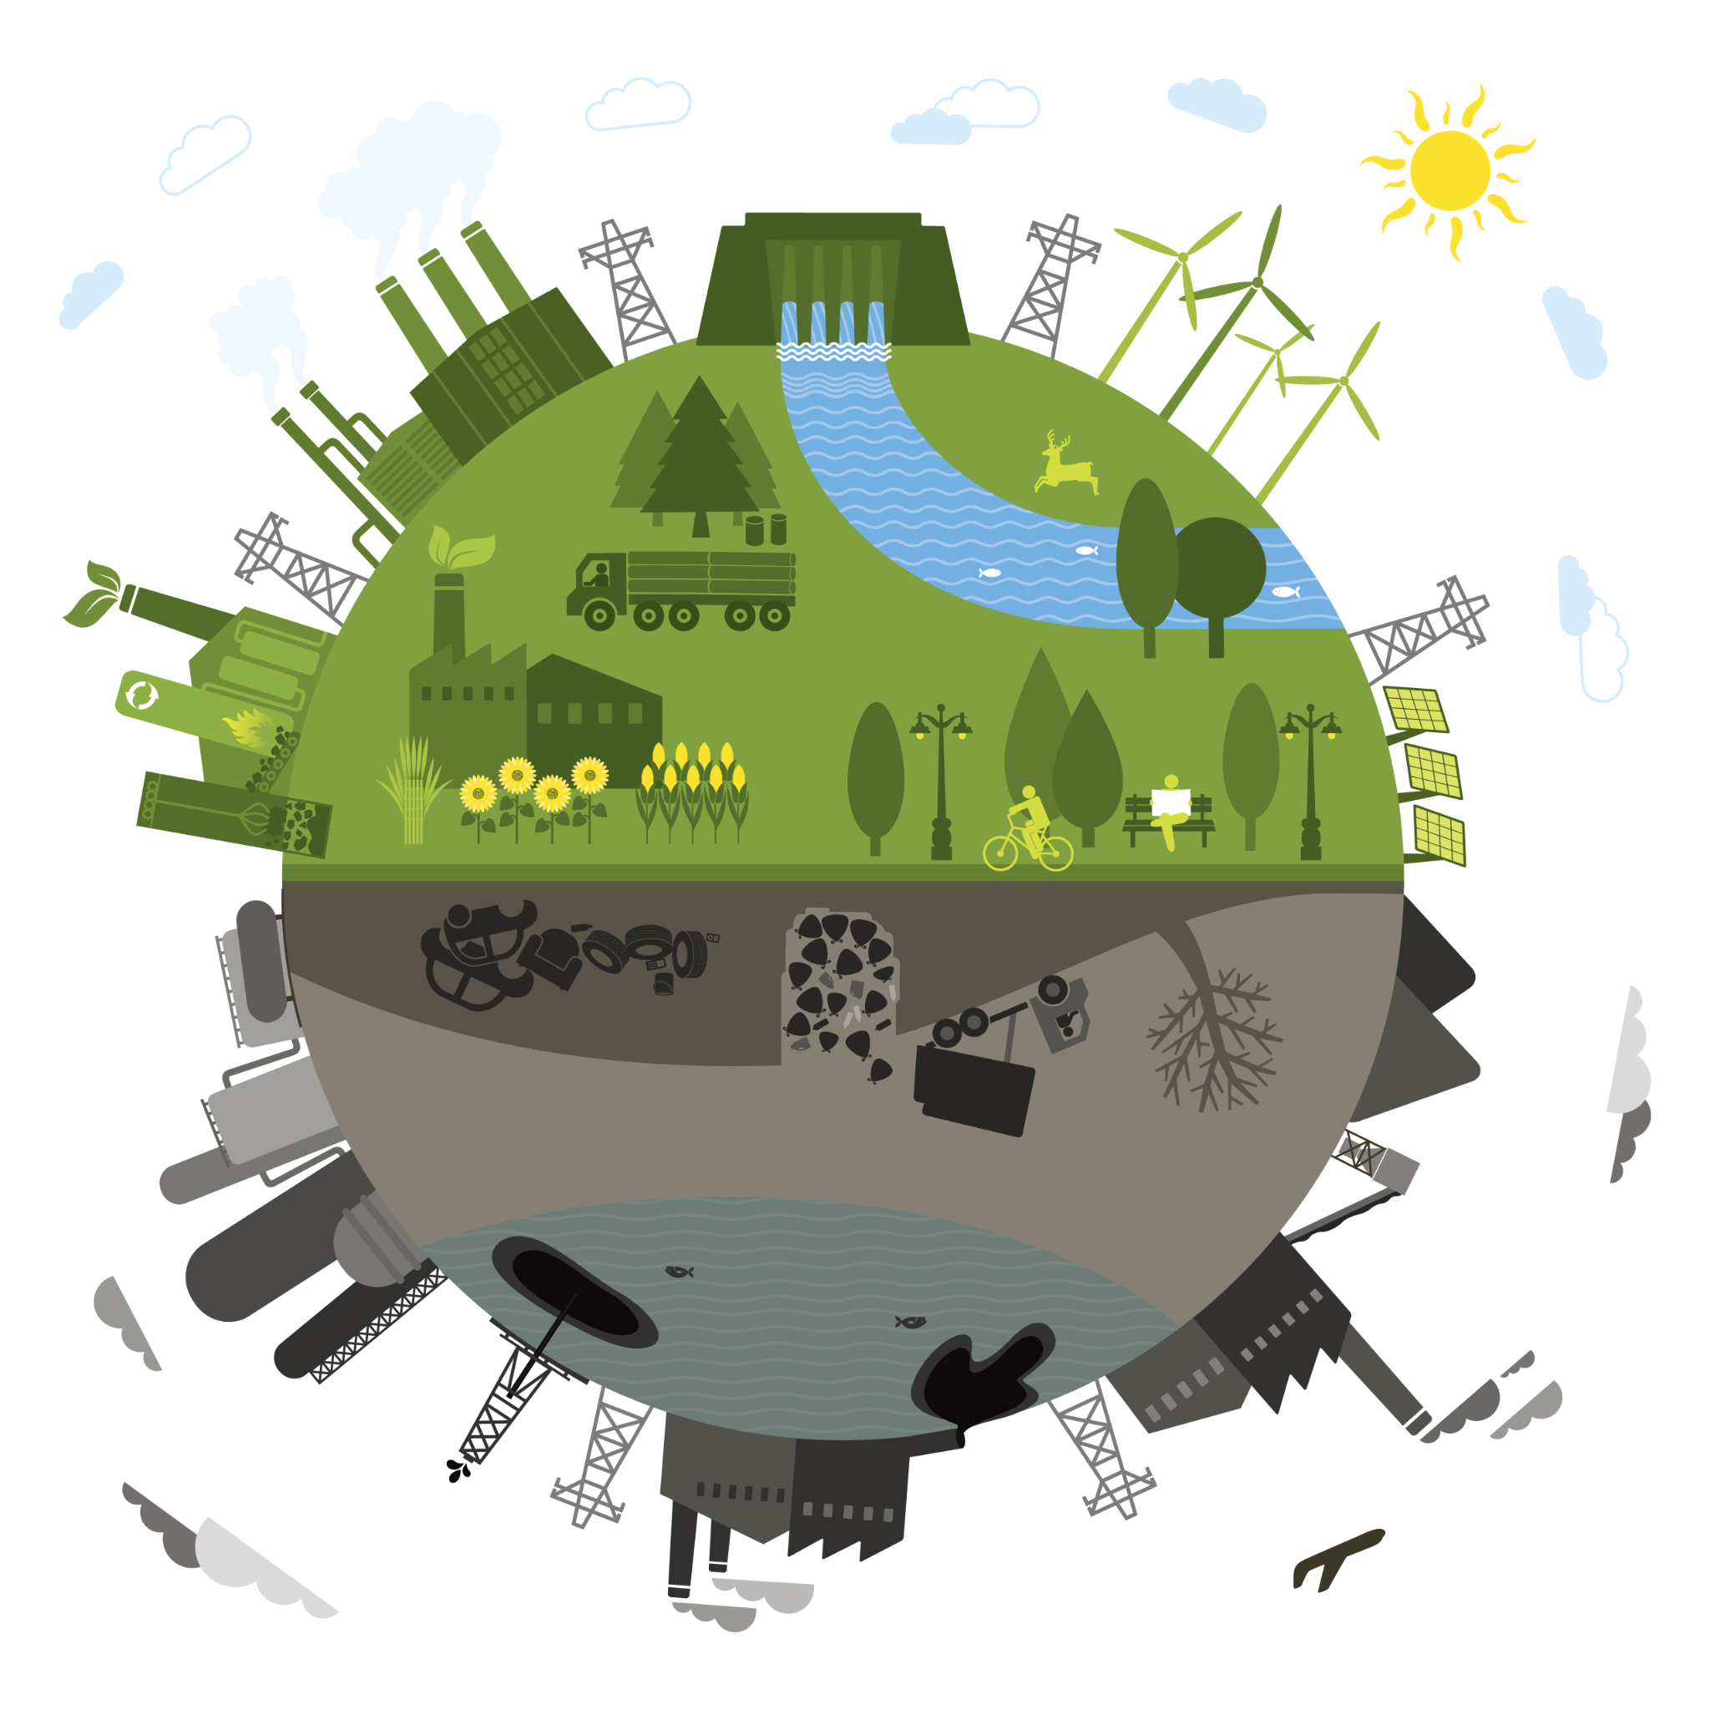
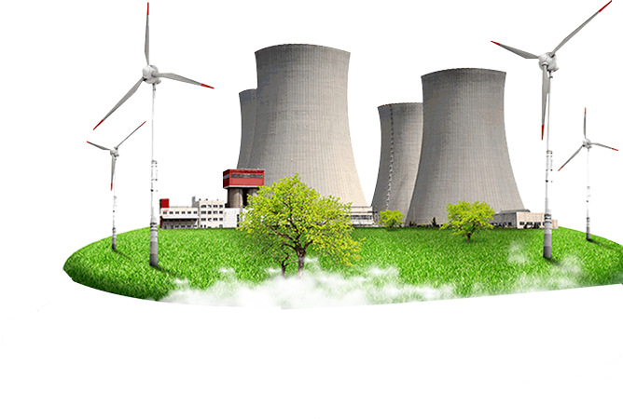
Autumn One: Electricity
Vocabulary Word | Meaning
Resistance | The difficulty that the electric current has when flowing around a circuit.
Parallel Circuit | An electrical path that branches so that the current divides and only part of it flows through any branch.
Series Circuit | A series circuit is a loop with components arranged one after another.
Each component in a circuit can be represented by a recognised symbol
M
Motor
Wire
Lamp
Buzzer
Cell
If one or more component is placed in a continuous loop this is called a series circuit. If they are in separate loops, this is called a parallel circuit.
Fossil fuels are non-renewable sources of energy. Solar, wind, geothermal and tidal are sources of renewable energy.
Mains electricity is generated by power stations and provides the energy for many home appliances.

Slide 2
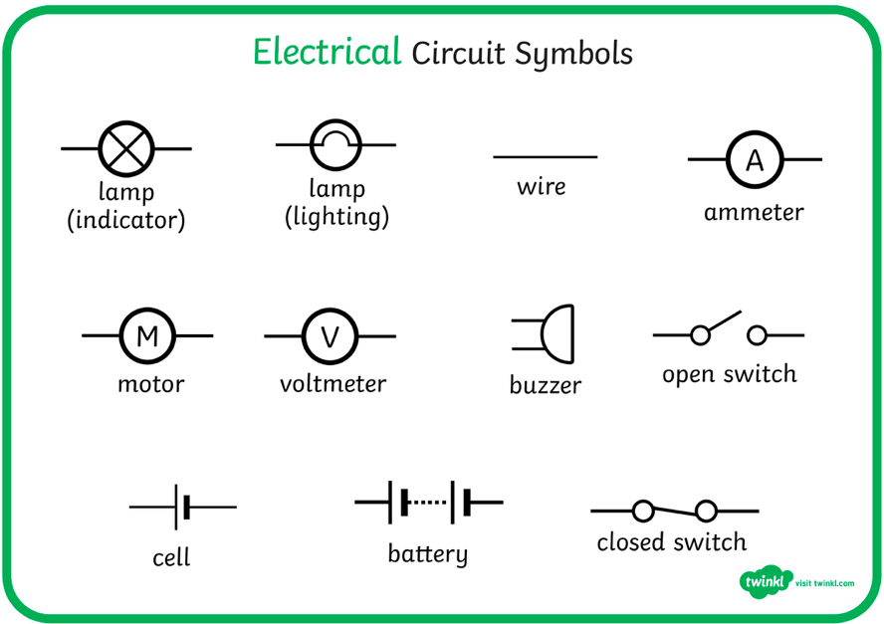
Autumn 1: Electricity
Key knowledge
Vocabulary
Lessons
Vocabulary Word | Meaning
Electrons | Very small particles that travel around an electrical circuit.
Circuit | A path that an electrical current can flow around.
Current | The flow of electrons, measured in amps.
Amps | How electric current is measured.
Cell/ Battery | A device that stores chemical energy until it is needed. A cell is a single unit. A battery is a collection of cells.
Voltage | The force that makes the electric current move through the wires. The greater the voltage, the more current will flow.
Resistance | The difficulty that the electric current has when flowing around a circuit.
Motor | Turns electrical energy to movement.
L1 | Research information about electrical safety, linking it to properties of materials.
L2 | Investigate how voltage affects bulbs and buzzers
L3 | Work systematically to investigate the effect when changing different components in a circuit.
L4 | Draw diagrams with recognised symbols to represent circuits.
L5 | Research how circuits are used in real world situations e.g. traffic lights, burglar alarms.
L6 | Design, draw and label a device that uses knowledge of circuits.
Facts
We use scientific symbols to represent the components (parts) of a circuit.
The brightness of a bulb or the loudness of a buzzer is affected by the number, and voltage of, cells in a circuit.
The arrangement of components and length of wires in a circuit can affect how they function.

