Slide 1
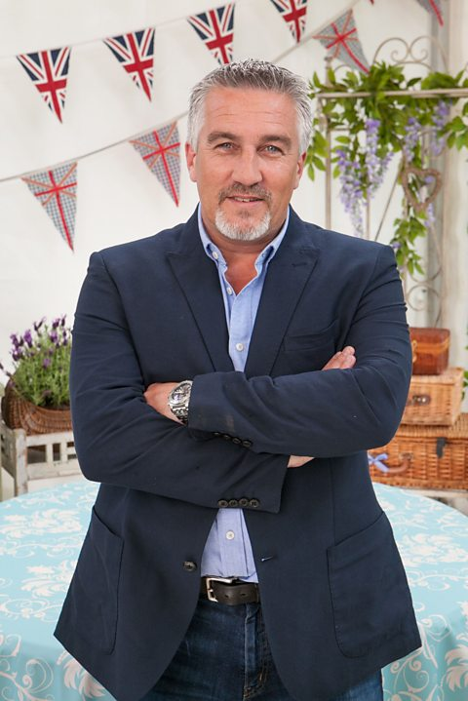
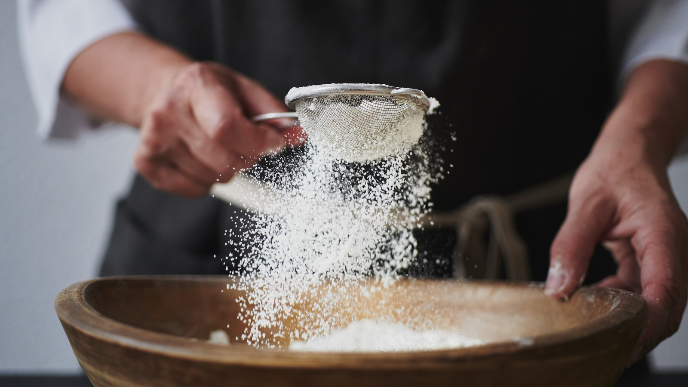
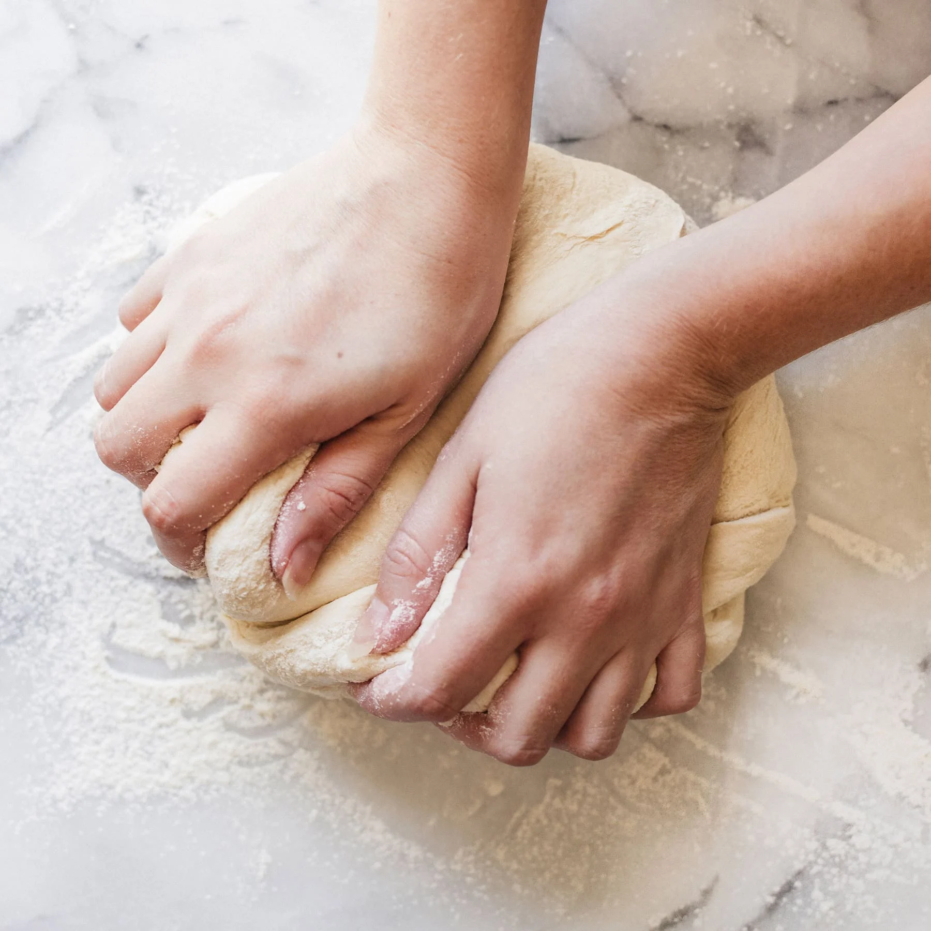
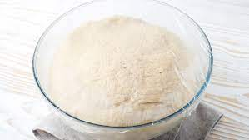
Year 5 DT – Autumn 1 Bread Making
Paul Hollywood
Key Vocabulary
allergy | your body’s immune system reacts unusually to specific food
intolerance | a difficulty digesting certain foods
leavened | a bread made with included a rising agents such as yeast
unleavened | a bread made without yeast or other rising agent
proving | allowing bread to rest for a time to allow the yeast to ferment creating a lighter, softer dough
The son of a baker, Paul originally trained as a sculptor until his father persuaded him to change careers. He has publishing the best-selling book '100 Great Breads' and has appeared as a judge on ‘The Great British Bake Off’, 'Junior Bake Off' on CBBC, and a celebrity version, 'The Great Sport Relief Bake Off'.
sieving
kneading
proving

Slide 2
Year 5 DT – Autumn 1 Bread Making
Paul Hollywood
Key Vocabulary
allergy | your body’s immune system reacts unusually to specific food
intolerance | a difficulty digesting certain foods
leavened | a bread made with included a rising agents such as yeast
unleavened | a bread made without yeast or other rising agent
proving | allowing bread to rest for a time to allow the yeast to ferment creating a lighter, softer dough
The son of a baker, Paul originally trained as a sculptor until his father persuaded him to change careers. He has publishing the best-selling book '100 Great Breads' and has appeared as a judge on ‘The Great British Bake Off’, 'Junior Bake Off' on CBBC, and a celebrity version, 'The Great Sport Relief Bake Off'.
sieving
kneading
proving

