Slide 1
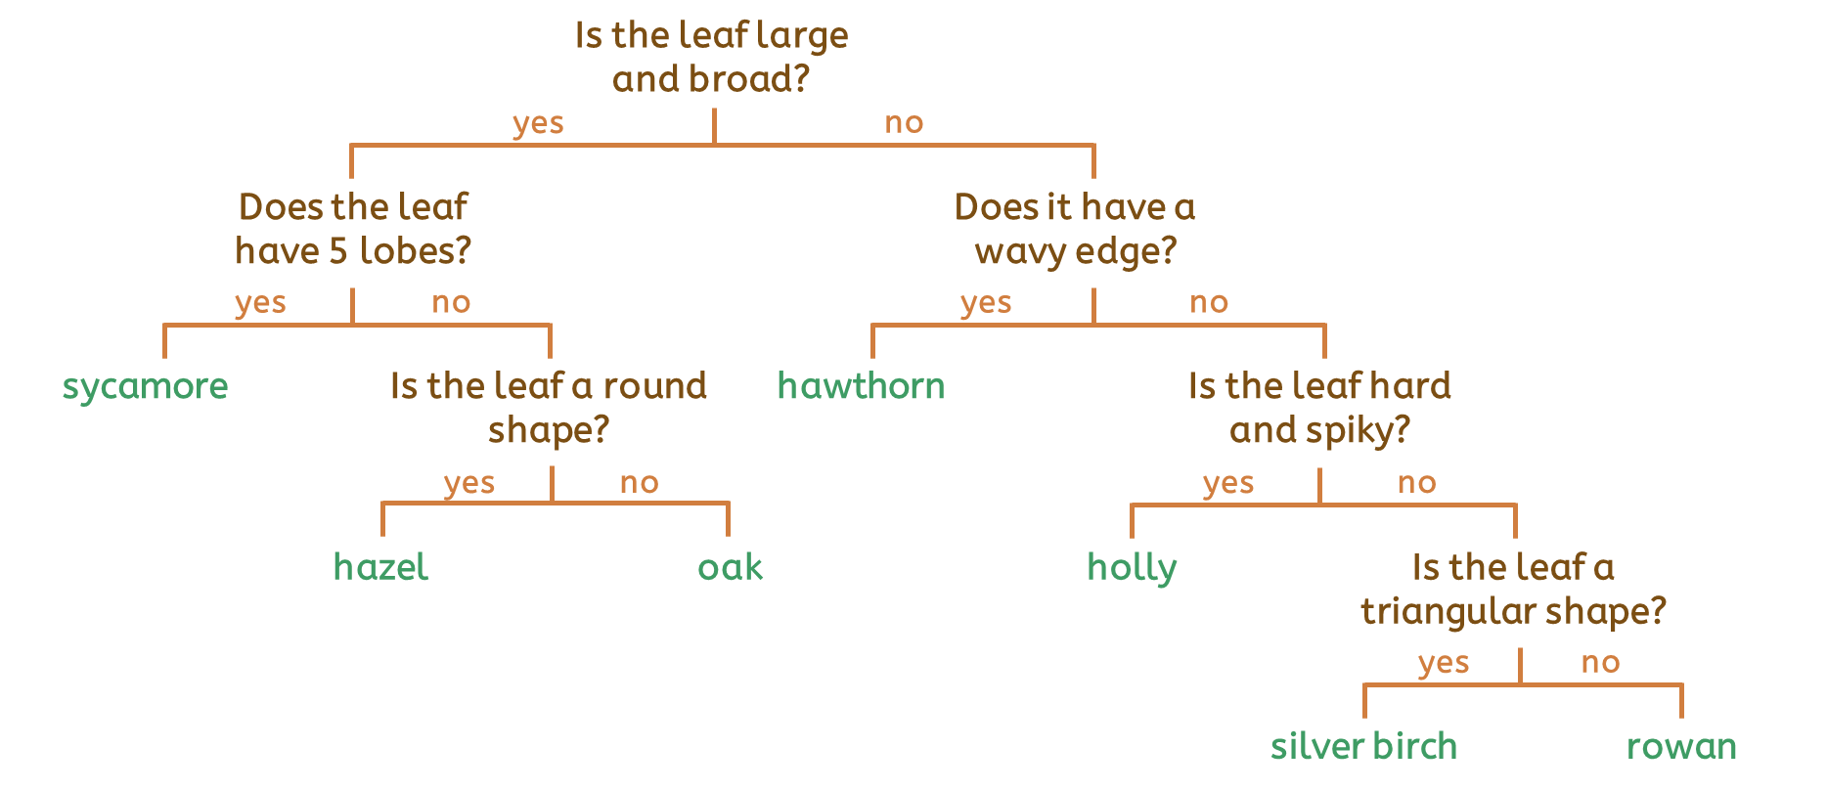
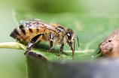

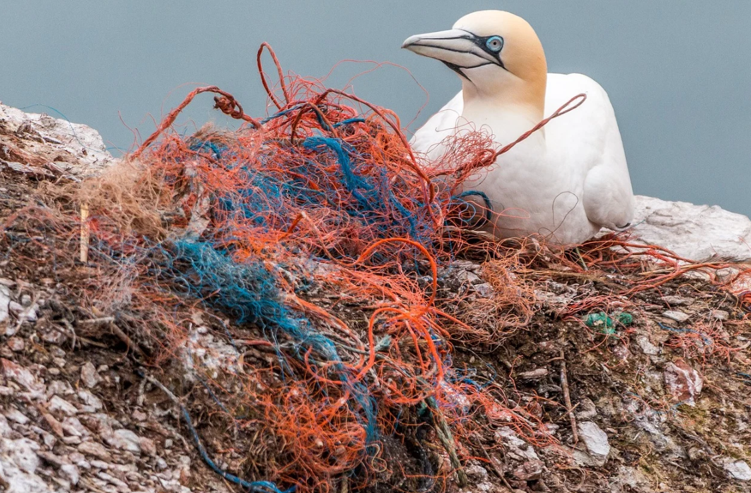
Term: Classifying Organisms
Vocabulary Word | Meaning
organism | All living things such as plants and animals.
vertebrates | These have a backbone and an endoskeleton (internal skeletons) and can be grouped into fish, mammals, amphibians, birds and reptiles.
invertebrates | These do not have a backbone or endoskeleton and are slugs, snails, insects, worms and spiders.
biodiversity | All the different livings things in an area.
We can use
classification keys to group
different types of animals and plants.
Classification describes how we can sort all organisms (living things) into groups.
Biodiversity is all the different living things in an area. Humans rely on biodiversity but it is also threatened by human actions.

