Slide 1

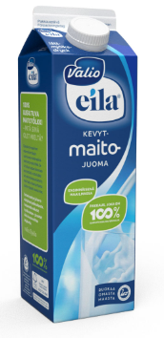
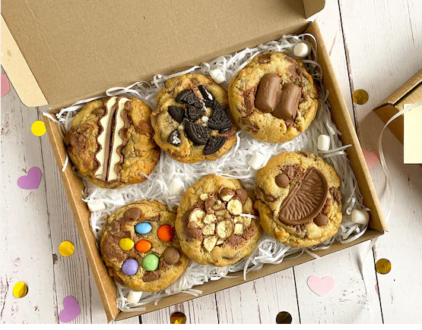
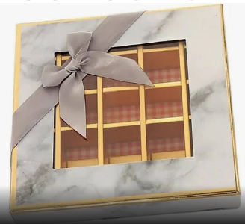
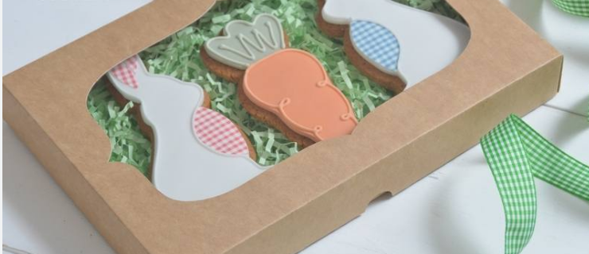
Year 4 DT – Autumn 1 Shell Structures
Key Vocabulary
Designer
net | a term used to describe what a 3D shape would look like if it was opened out and laid flat
durable | able to withstand wear, pressure, or damage; hard-wearing
laminated | composed of layers of firmly united material
corrugated | molded into tight ridges and valleys
manufacture | the making of goods or wares by manual labor or by machinery, especially on a large scale
Ruben Rausing
biscuit box
window
presentation

