Slide 1
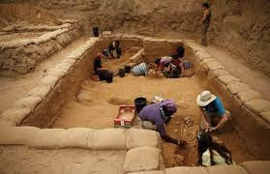
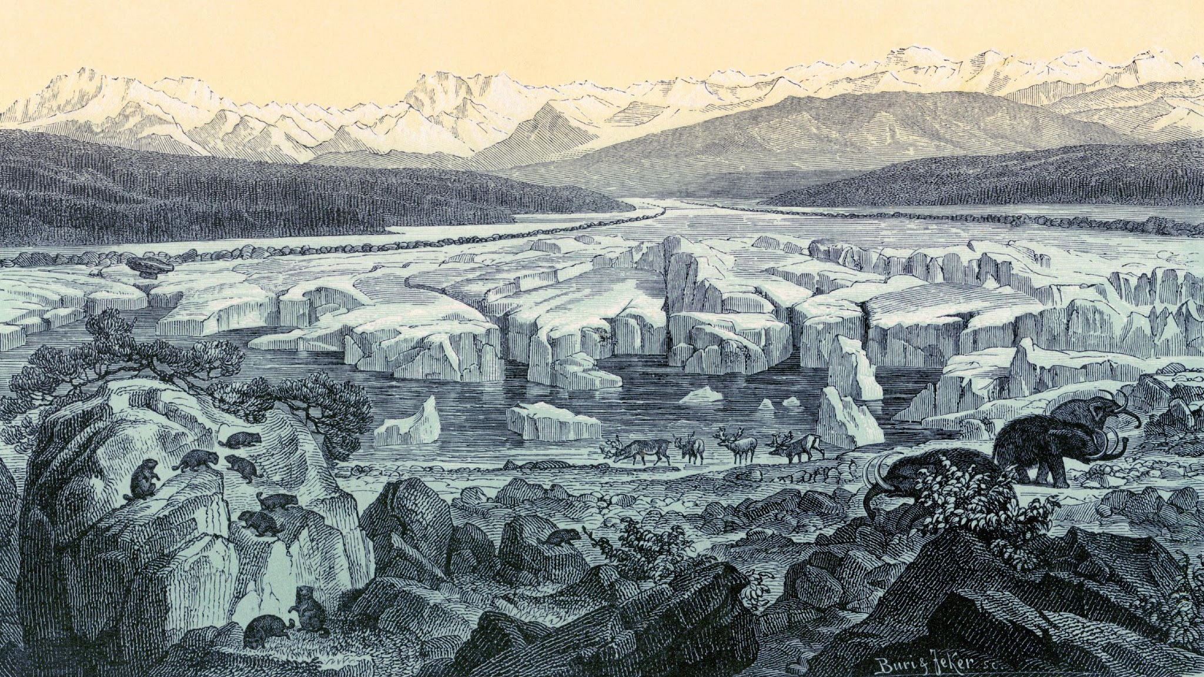
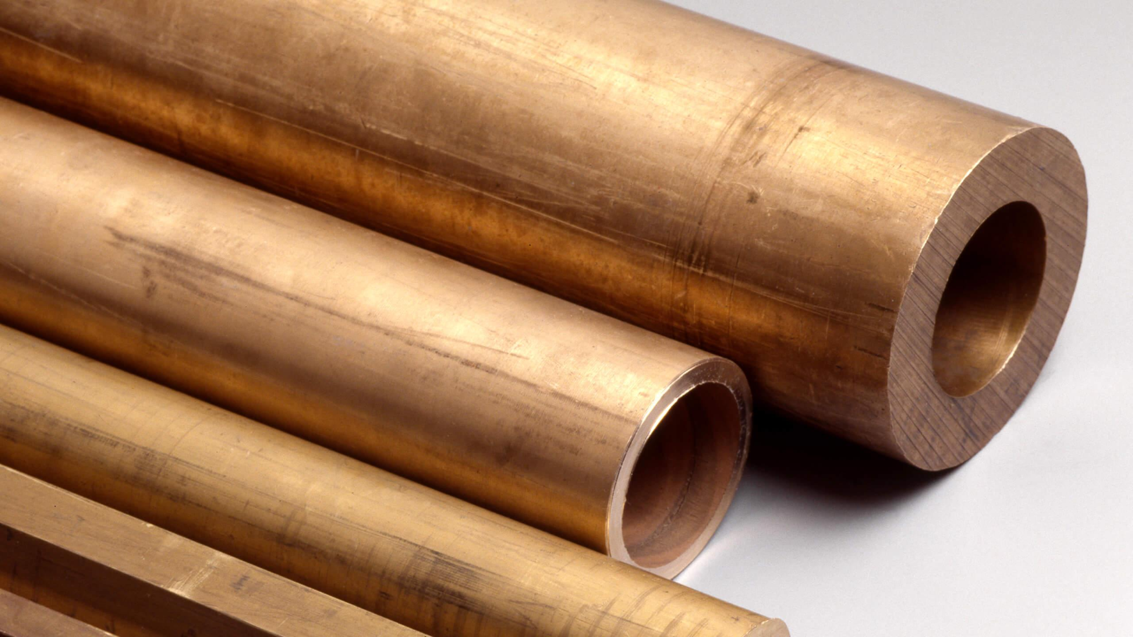
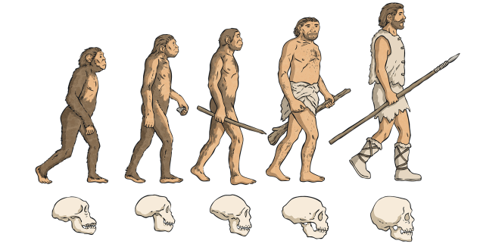
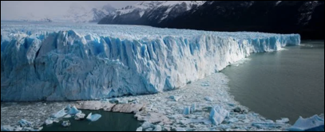



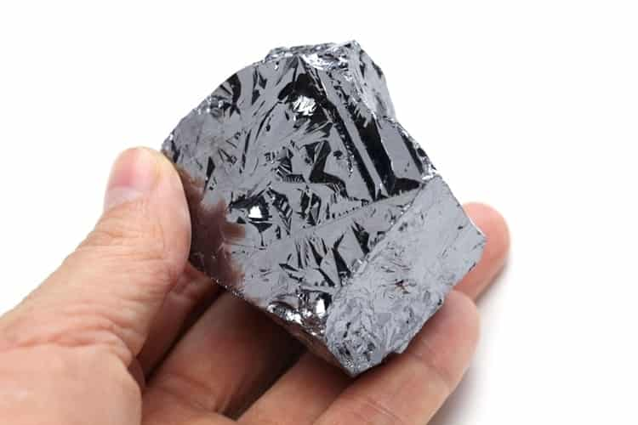
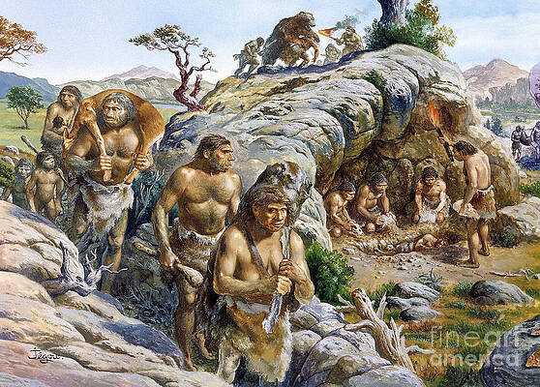
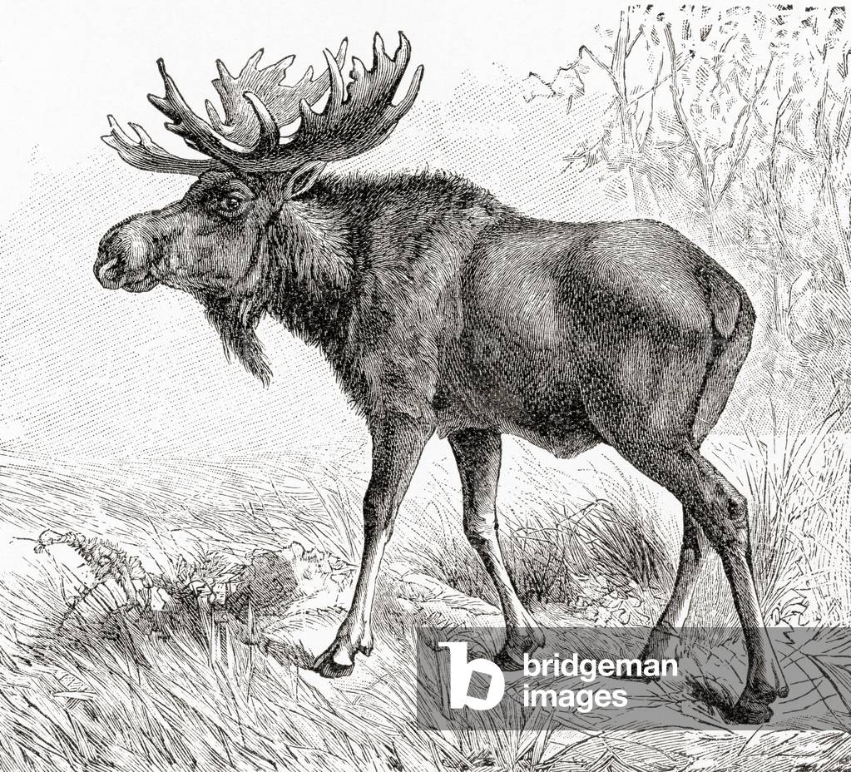




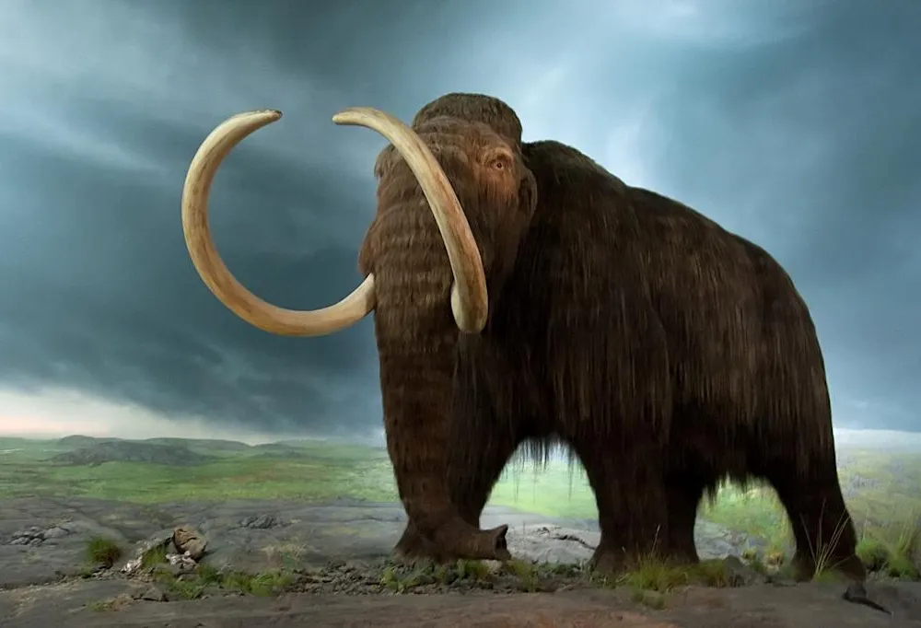
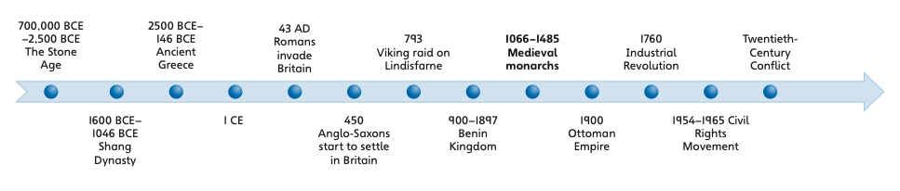
Prehistoric
Britain
archaeologist
Ice Age
bronze
Prehistoric animals
evolve
Woolly
mammoth (extinct)
glacier
Woolly rhino (extinct)
Elk
(extant)
ore
neanderthals
Stone Age tools
homo sapiens
extant
extinct
Spear Hand axe Hammer stones

