Slide 1
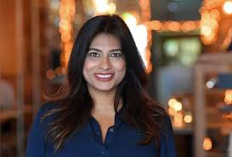

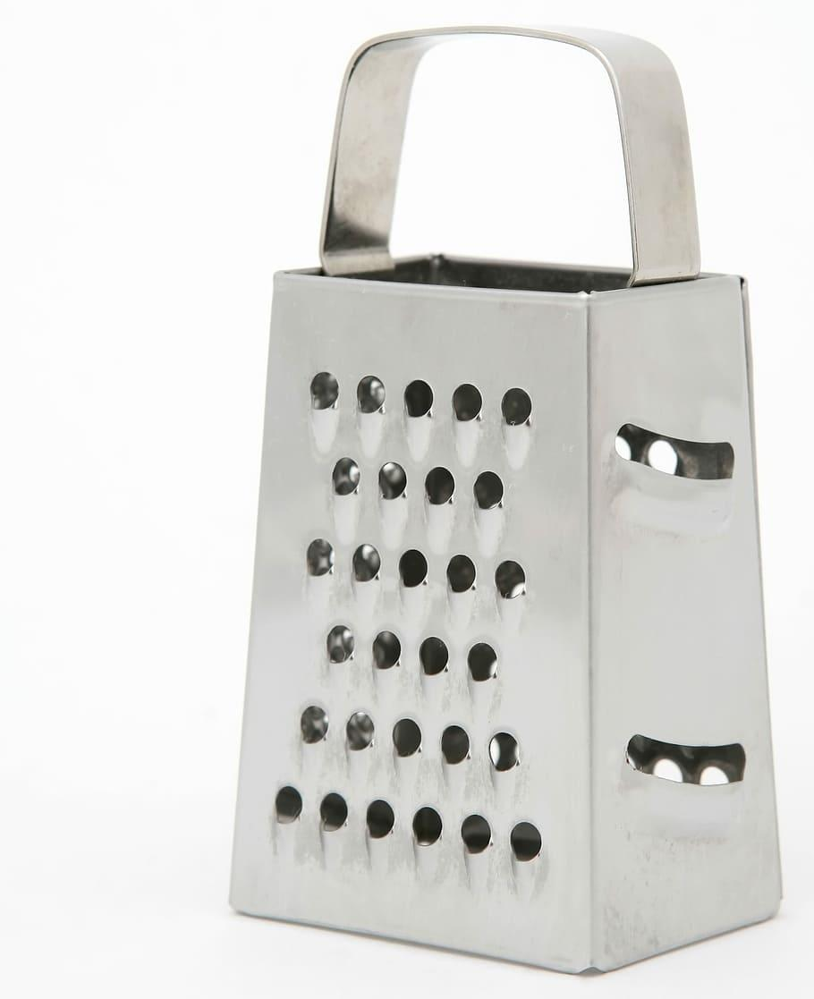
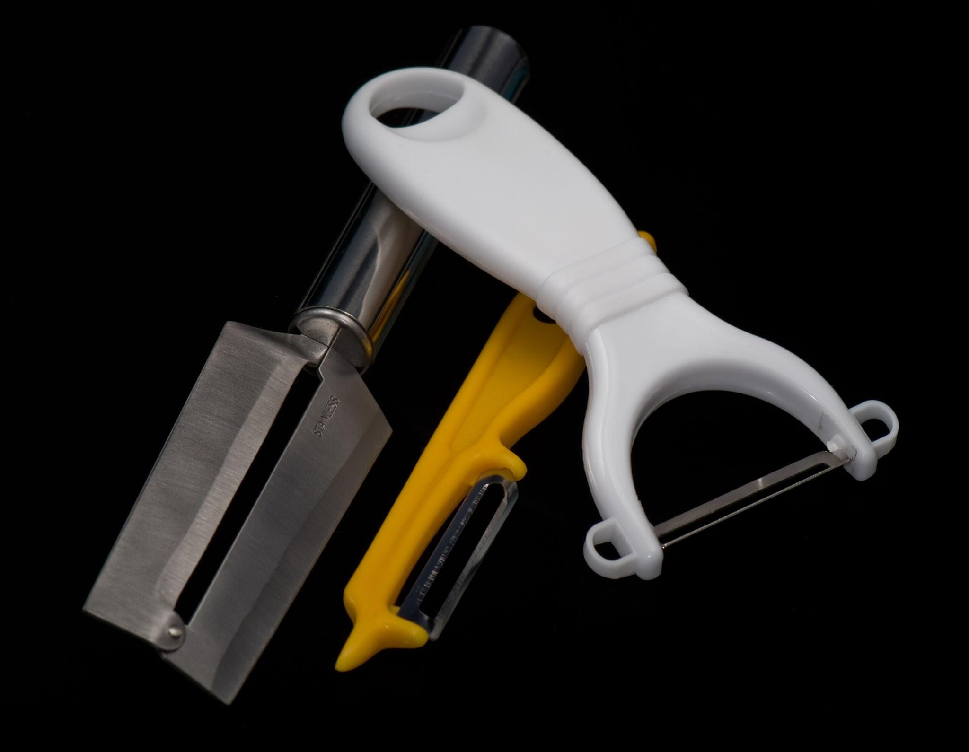
Year 3 DT – Autumn 1 Healthy and Varied Diet
Key Vocabulary
Nisha Katona
fresh | Not tinned frozen or otherwise preserved
processed | Any food that has been altered in any way during preparation
grown | When it comes from a plant
reared | Brought up from young to an adult in a human controlled environment (e.g. a farm)
caught | Catching something in a net
Nisha Katona, MBE is a British restaurateur and TV personality. The daughter of two doctors, she is the founder of Mowgli Street Food restaurants and the Mowgli Trust charity, a food writer and television presenter
grater
knife
peeler

Slide 2
Year 3/4 DT – Autumn 1 Healthy and Varied Diet
Key Vocabulary
Nisha Katona
fresh | Not tinned frozen or otherwise preserved
processed | Any food that has been altered in any way during preparation
grown | When it comes from a plant
reared | Brought up from young to an adult in a human controlled environment (e.g. a farm)
caught | Catching something in a net
Nisha Katona, MBE is a British restaurateur and TV personality. The daughter of two doctors, she is the founder of Mowgli Street Food restaurants and the Mowgli Trust charity, a food writer and television presenter
grater
knife
peeler

Slide 3
Year 3 DT – Autumn 1 Healthy and Varied Diet
Key Vocabulary
Nisha Katona
fresh | Not tinned frozen or otherwise preserved
processed | Any food that has been altered in any way during preparation
grown | When it comes from a plant
reared | Brought up from young to an adult in a human controlled environment (e.g. a farm)
caught | Catching something in a net
Nisha Katona, MBE is a British restaurateur and TV personality. The daughter of two doctors, she is the founder of Mowgli Street Food restaurants and the Mowgli Trust charity, a food writer and television presenter
grater
knife
peeler

