Slide 1
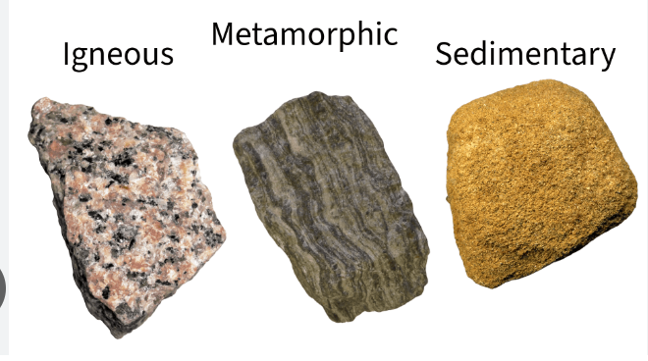
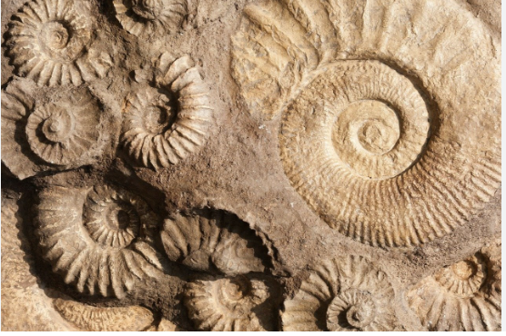
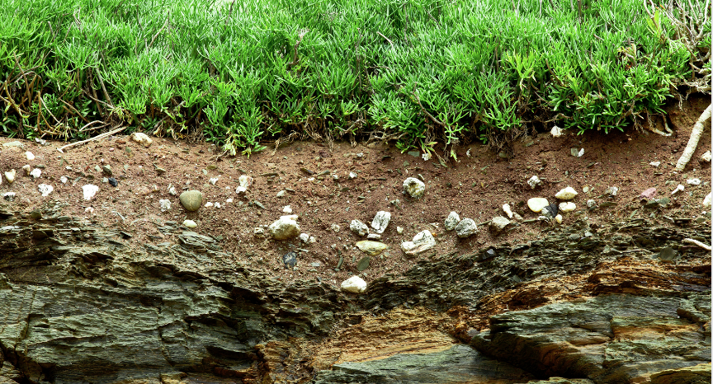
Autumn 1: Rocks
Vocabulary Word | Meaning
anthropic rock | A man-made ‘rock’ like bricks or concrete. They are not true rocks!
igneous | A rock that is formed when hot magma or lava cools down
sedimentary | A rock that is formed when layers of sediment are compacted (pressed together) to form a rock
metamorphic | A rock that is formed when any type of rock is exposed to immense pressure or heat.
There are 3 types of natural rocks:
Fossils are the preserved remains or traces of dead organisms.
Some rocks are permeable and some rocks are impermeable.

Slide 2
Year 3 Rocks (Chemistry) Endpoints
Know that rocks and soil differ in their appearance and properties
Know that there are different types of rocks and how they are formed
Know that fossils are evidence of life and how they are formed

