Slide 1
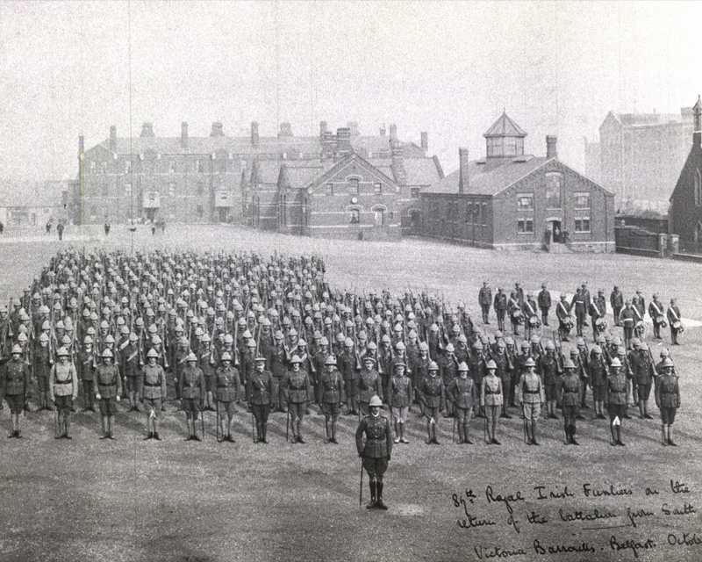

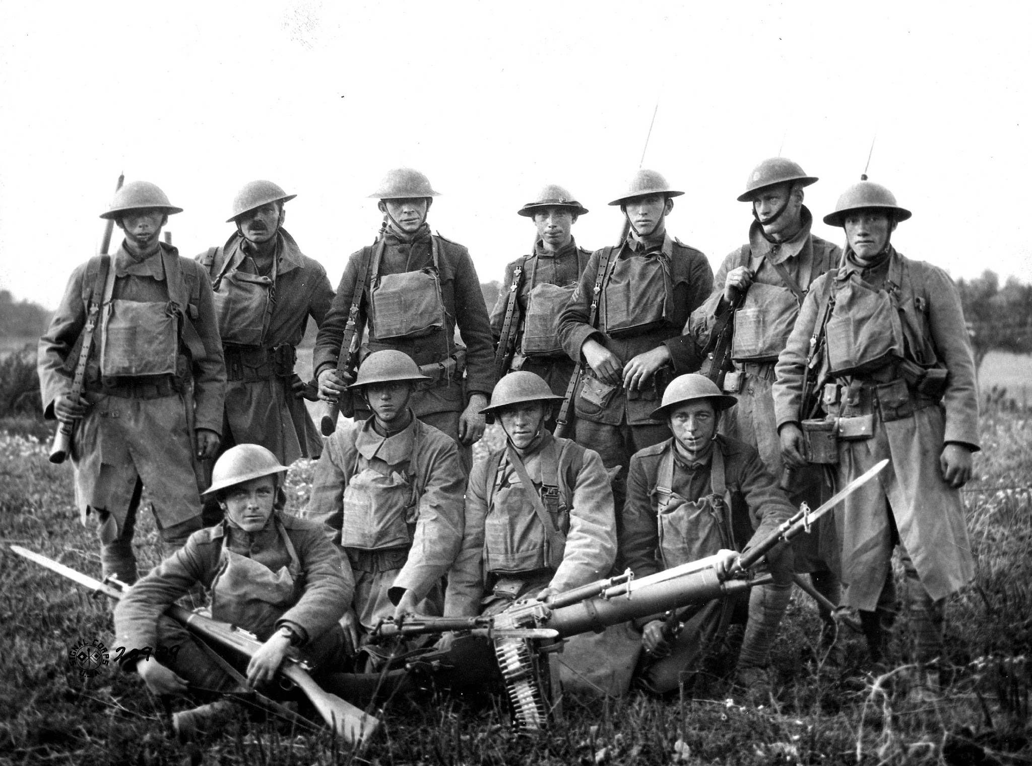
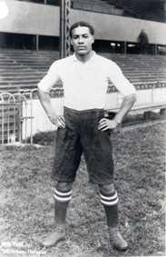
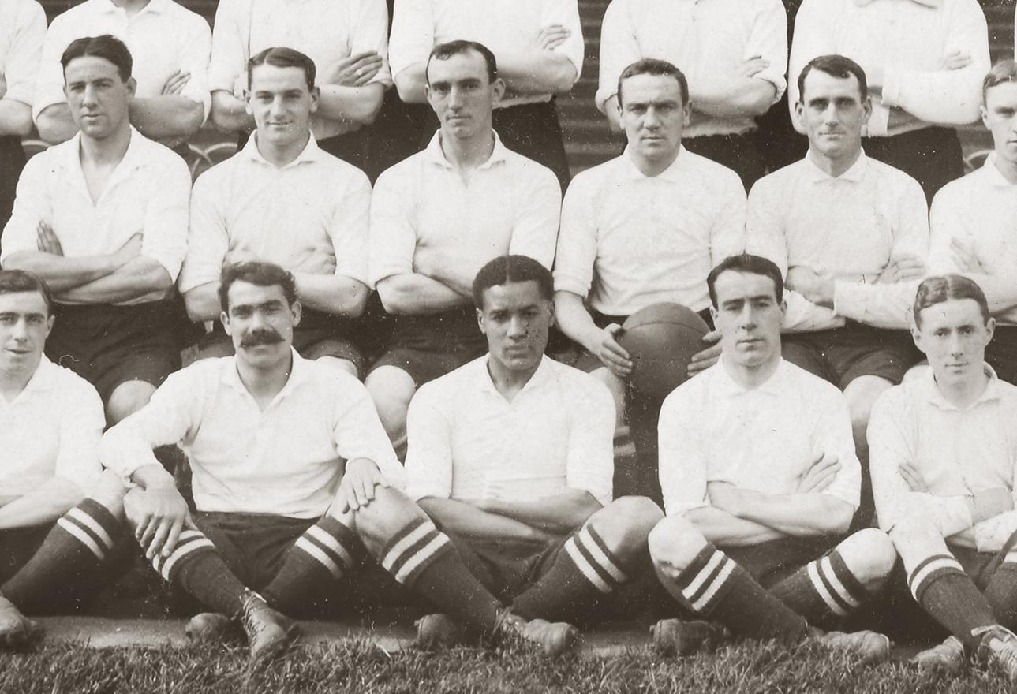
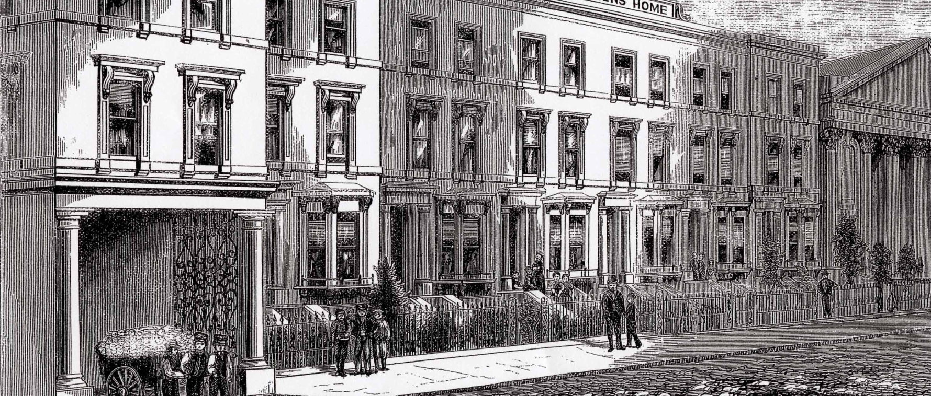
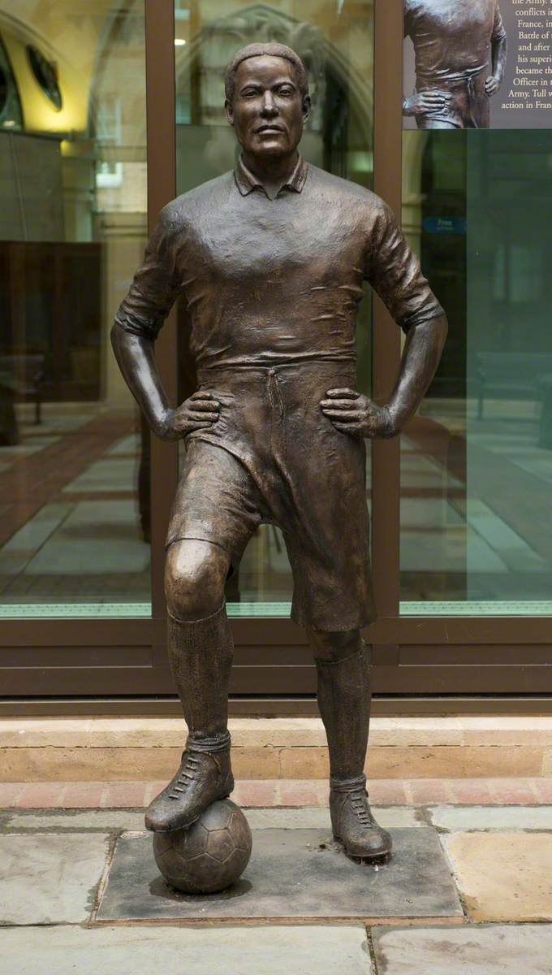
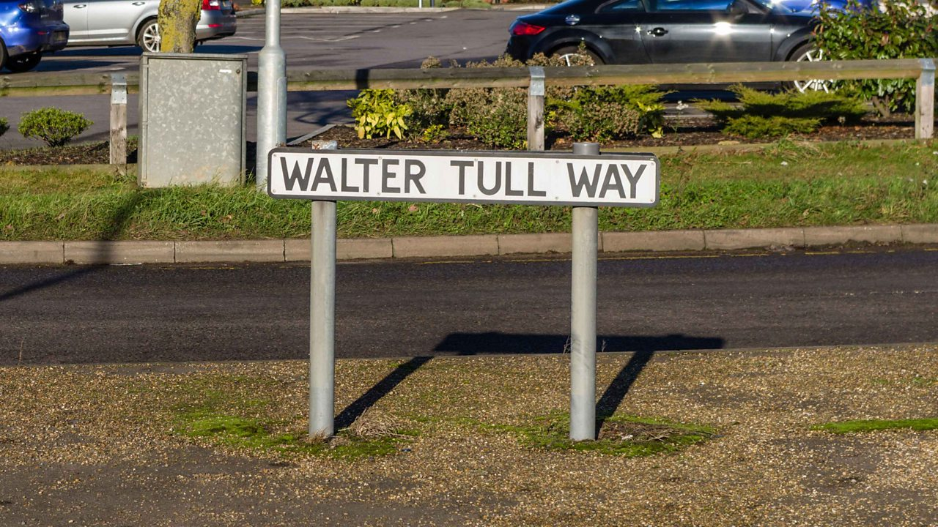
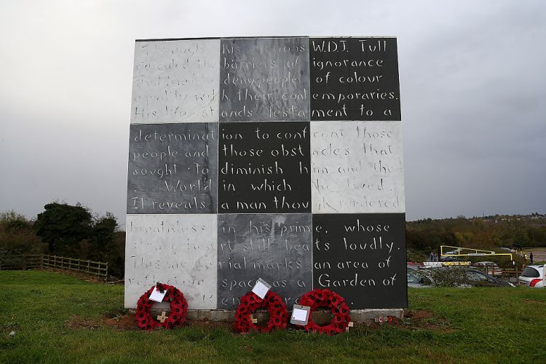
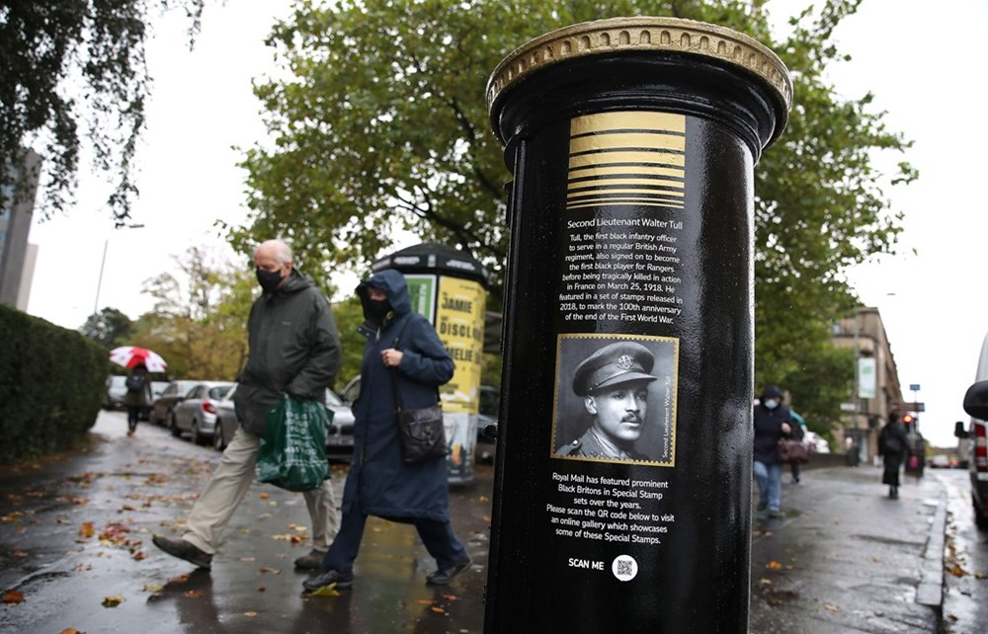

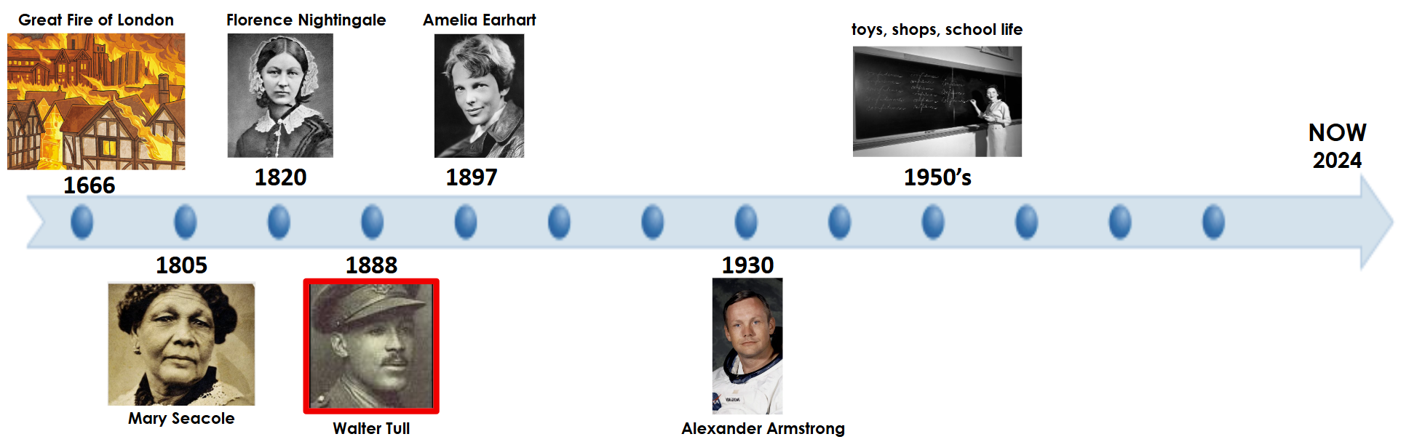
Walter Tull
battalion
racism - treating someone differently because of their skin colour
Tottenham Hotspur
World War One (WW1)
orphanage
Tottenham Hotspur signed Walter Tull in the early 1900s.
Walter Tull Memorials
Then
Now
Neil Armstrong

Slide 2
Walter Tull
battalion
racism - treating someone differently because of their skin colour
Tottenham Hotspur
World War One (WW1)
orphanage
Tottenham Hotspur signed Walter Tull in the early 1900s.
Walter Tull Memorials
Then
Now
Neil Armstrong

Slide 3
Walter Tull
battalion
racism - treating someone differently because of their skin colour
Tottenham Hotspur
World War One (WW1)
orphanage
Tottenham Hotspur signed Walter Tull in the early 1900s.
Walter Tull Memorials
Then
Now
Neil Armstrong

