Slide 1
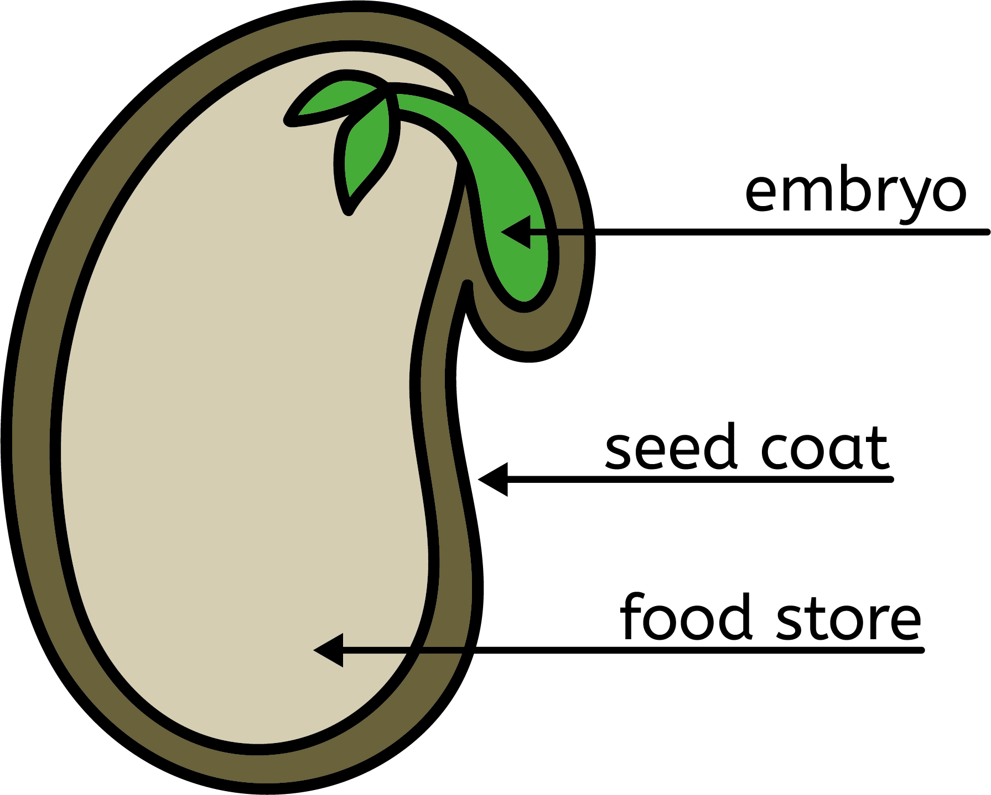
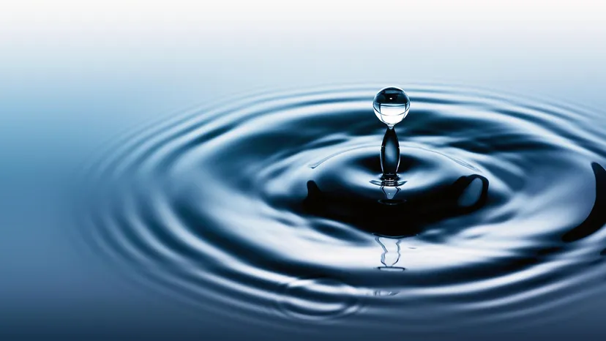
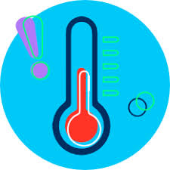

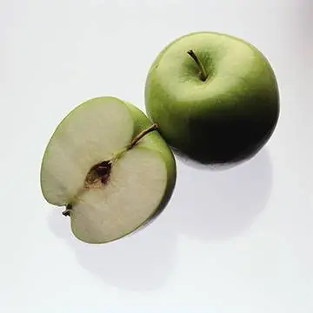
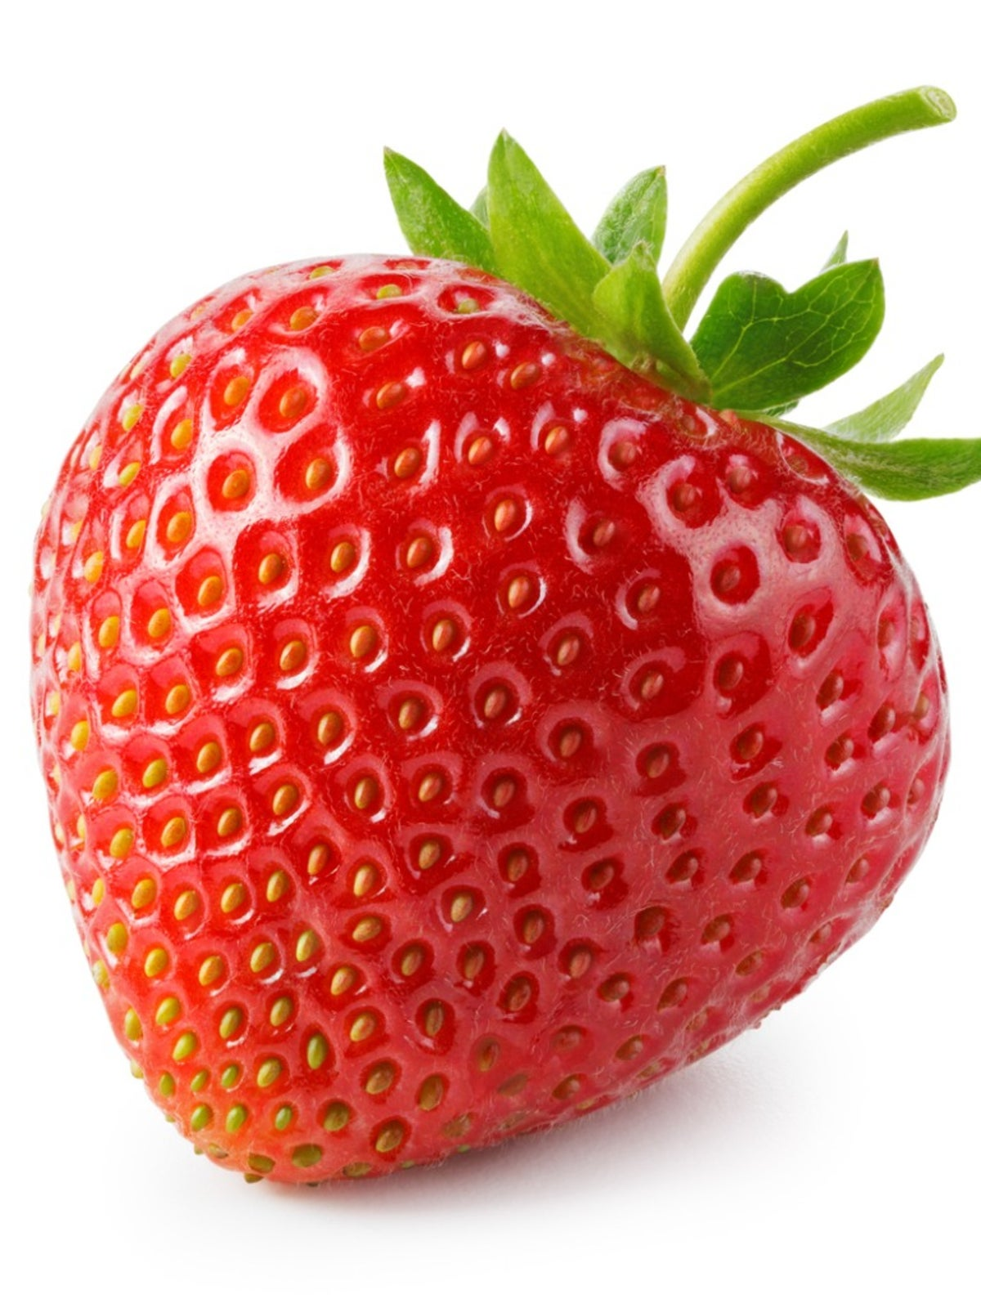
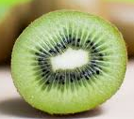
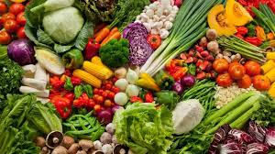
Autumn 1: Plant Growth
Seeds
Seeds are alive. They are dormant.
Germination | Plant Growth
The seed starts to develop into a plant. | The stem gets longer and wider and they develop more leaves.
The embryo is a very small plant, which has a small shoot, root and leaves.
The seed coat is a protective, tough layer.
Needs
Needs
water
water
Right temperature
Right temperature
The endosperm contains all the food the seed needs.
light
Fruits | Vegetables

Slide 2
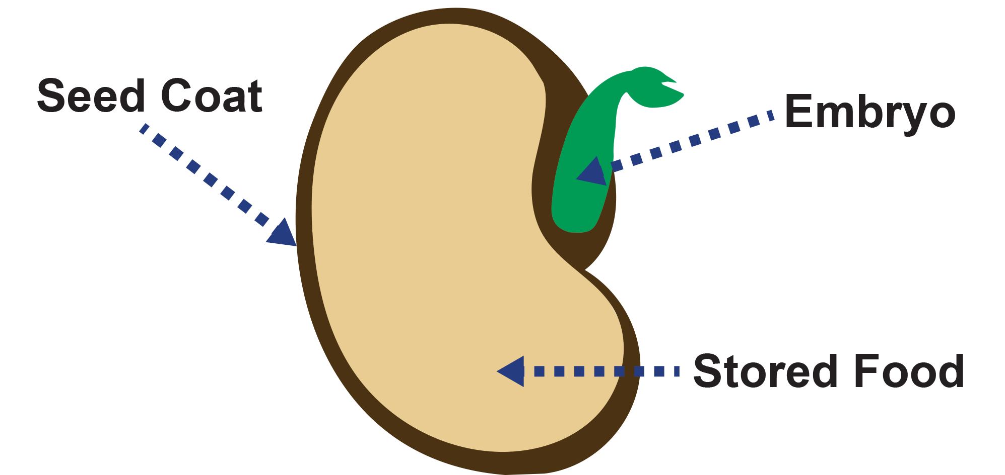
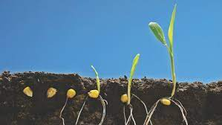
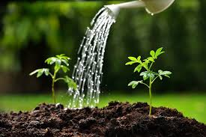
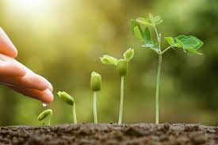
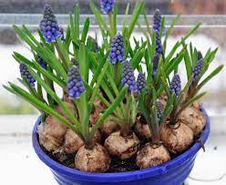
Autumn 1: Plant Growth
Vocabulary Word | Meaning
Seed | A small hard part of a plant from which a new plant can grow.
Dormant | Something that is alive but inactive.
Germination | The process by which a plant develops from a seed.
Temperature | The measure of how hot or cold something is.
Bulb | An underground storage organ in some plants
Know that a seed is living and is made up of different parts.
Know that germination is the development of a plan from a seed.
Know that all plants need water, light and suitable temperature in order to grow.
Know that some plants can grow from bulbs.

