Slide 1
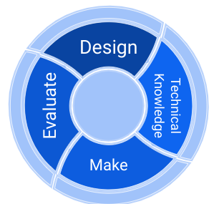
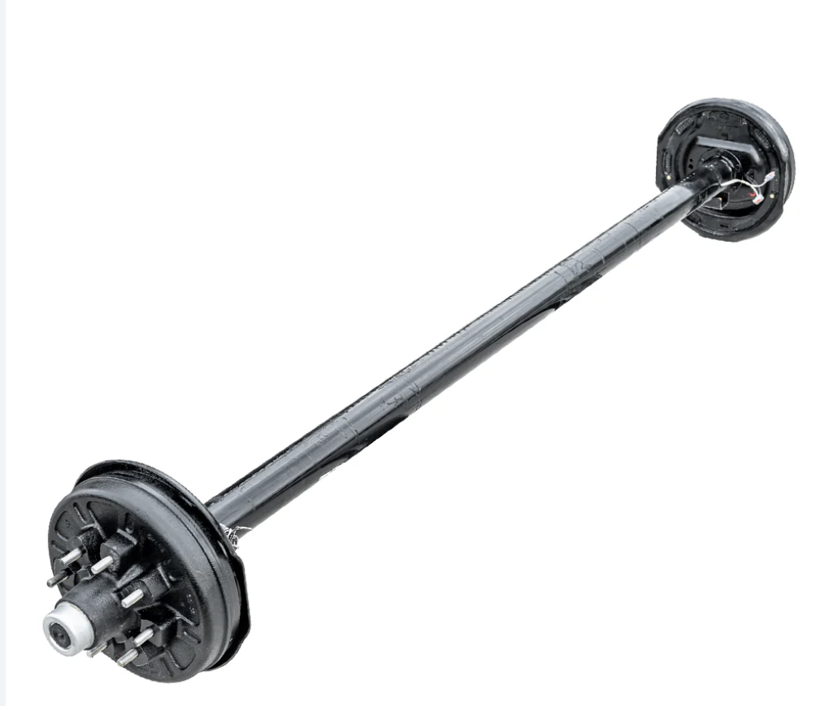
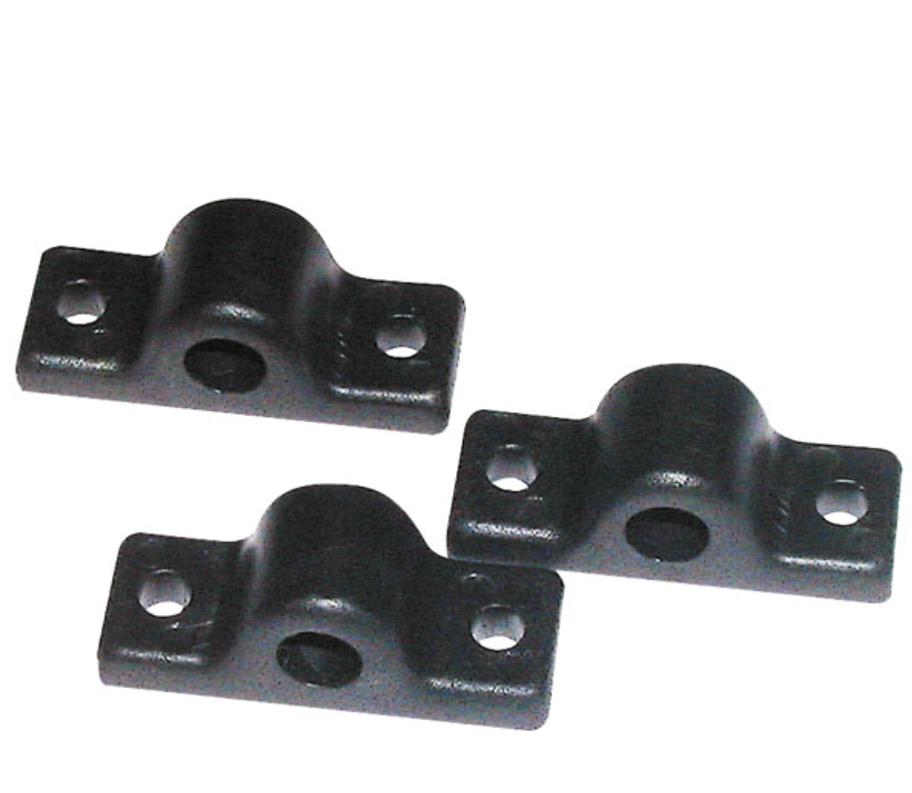
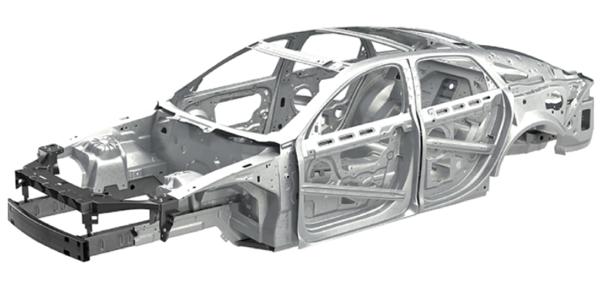
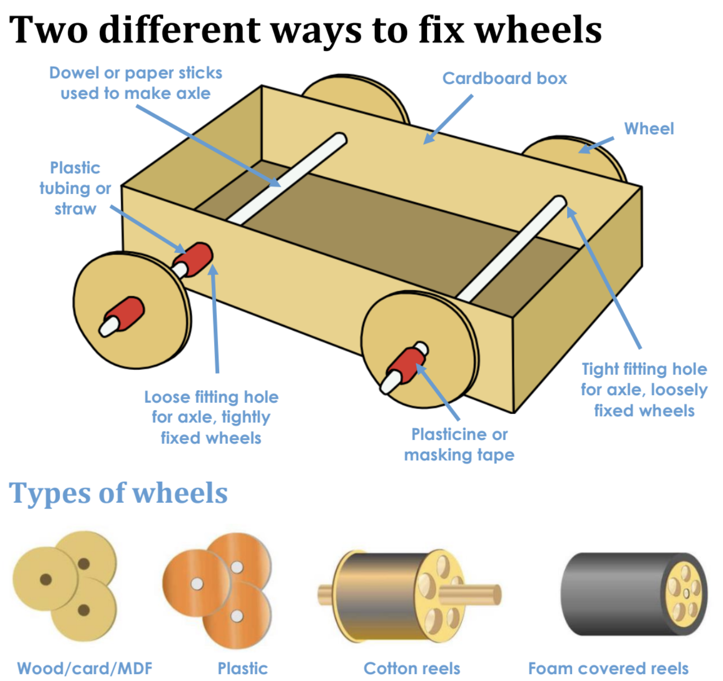
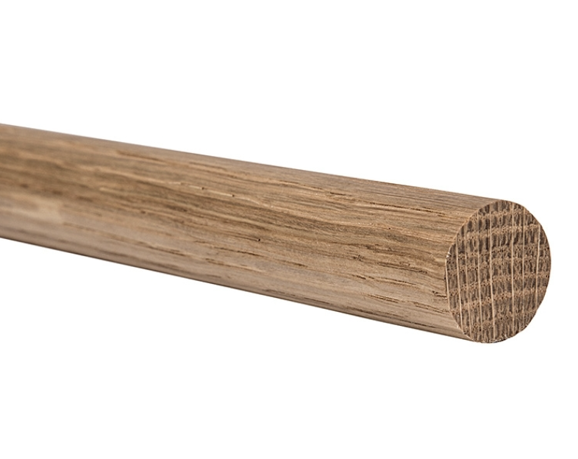

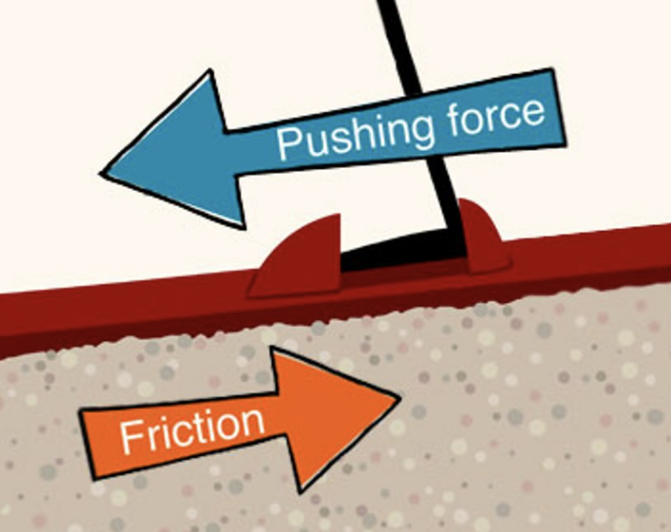

Year 2 Mechanisms
knowledge organiser
axle
axle holder
chassis
friction
dowel
purpose
slider
lever

Slide 2
Year 2 Mechanisms
knowledge organiser
axle
axle holder
chassis
friction
dowel
purpose
slider
lever

Slide 3
Year 2 Mechanisms
knowledge organiser
axle
axle holder
chassis
friction
dowel
purpose
slider
lever

