Slide 1
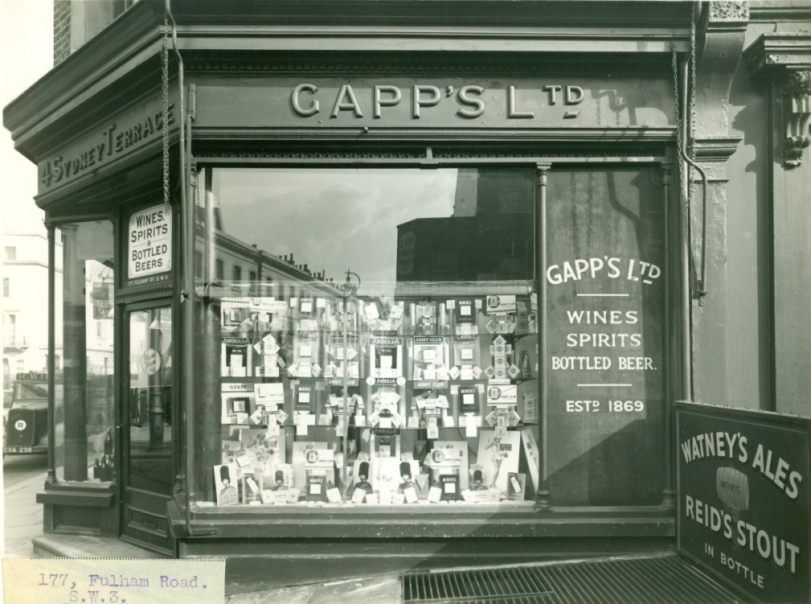
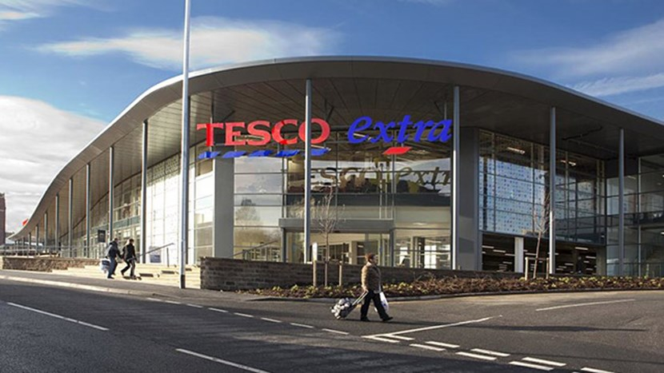
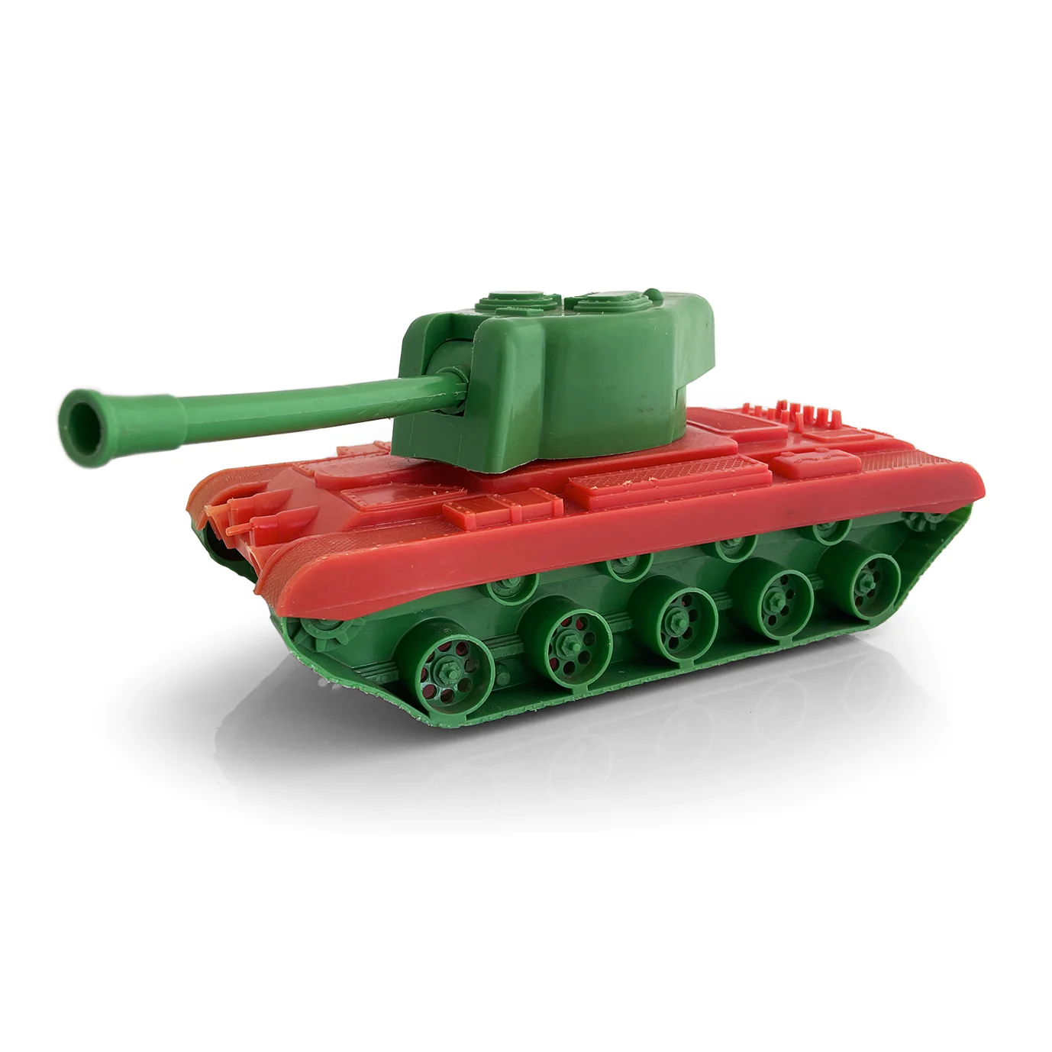
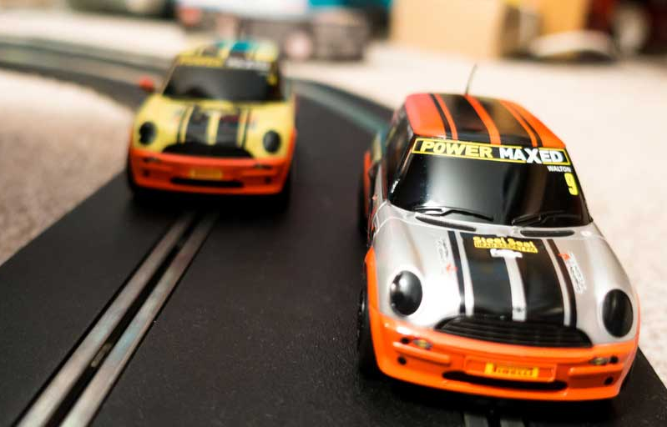
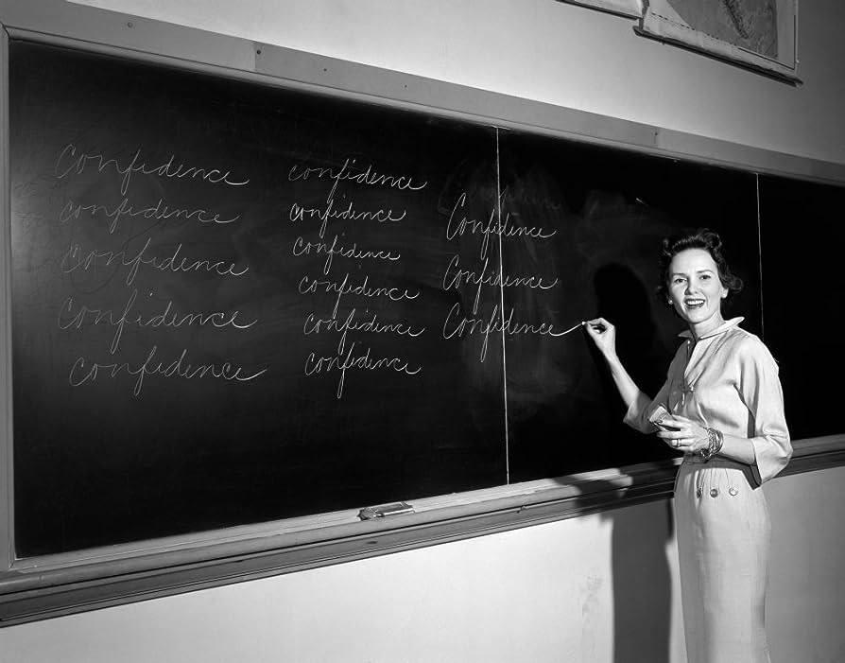

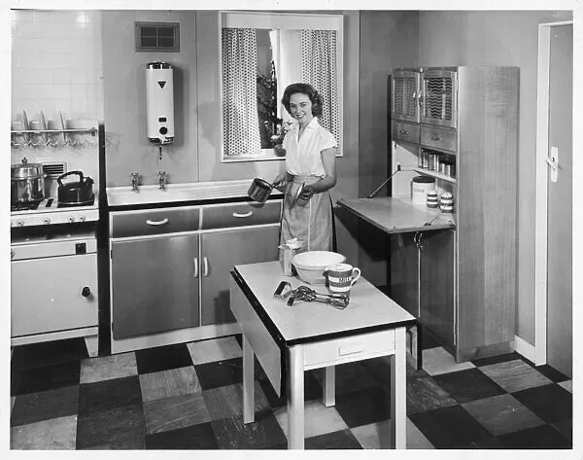
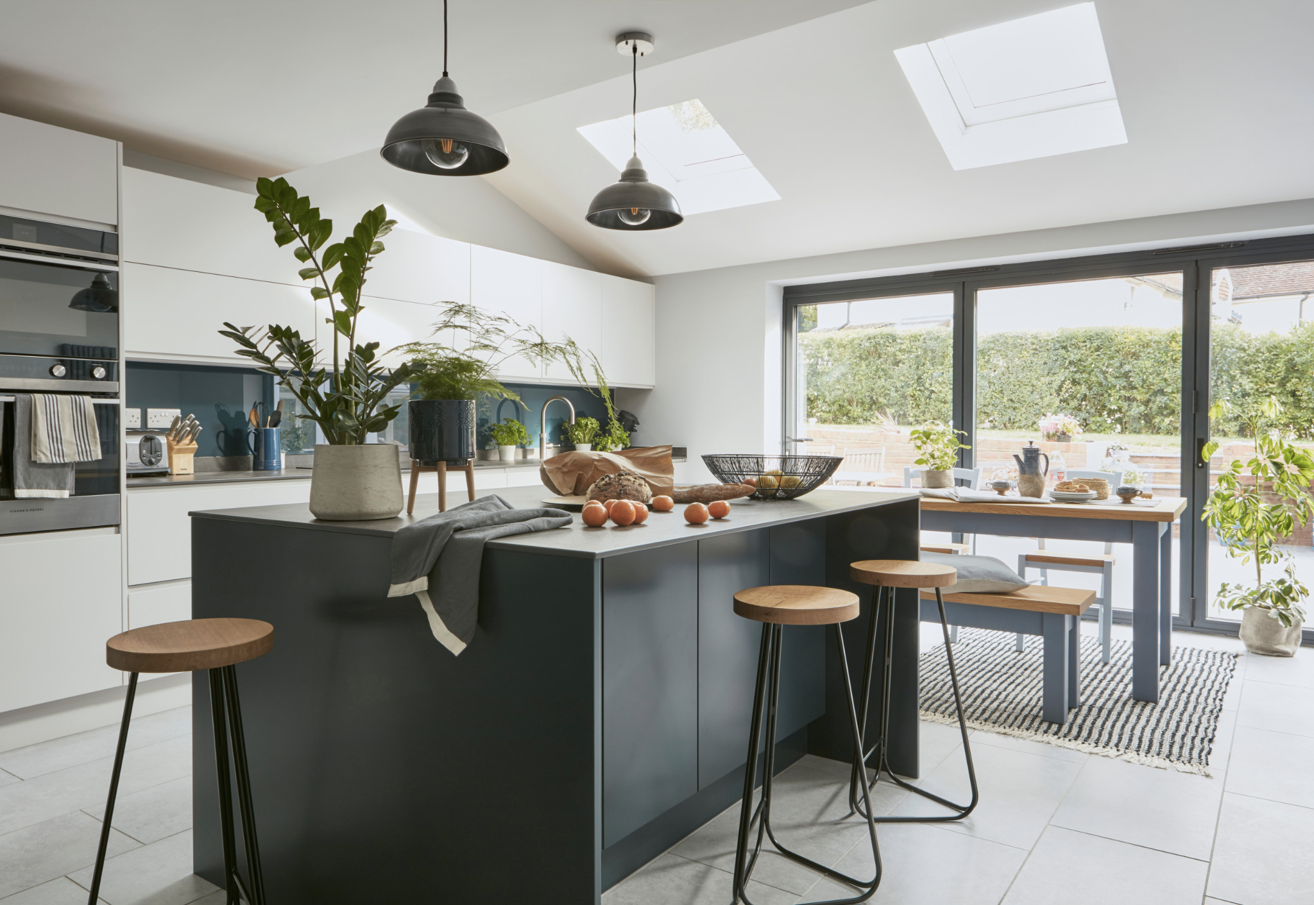
Then
1950s
Now
2026
Shops
Toys
Schools
Houses

Slide 2
Then
1950s
Now
2025
Shops
Toys
Schools
Houses

Slide 3
Then
1950s
Now
2023
Shops
Toys
Schools
Houses

Slide 4
Then
1950s
Now
2026
Shops
Toys
Schools
Houses

