Slide 1
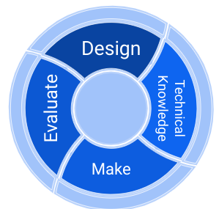
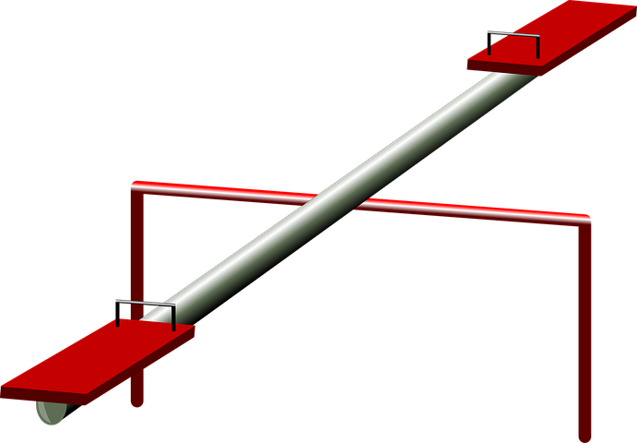

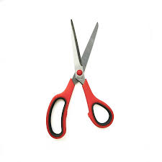




Year 1 Mechanisms
knowledge organiser
DT
process
pivot
greeting card
mechanism
user
product
purpose
slider
lever

Slide 2
Year 1 Mechanisms
knowledge organiser
DT
process
pivot
greeting card
mechanism
user
product
purpose
slider
lever

Slide 3
Year 1 Mechanisms
knowledge organiser
DT
process
pivot
greeting card
mechanism
user
product
purpose
slider
lever

