Slide 1



E-safety Workshop

Slide 2
Today’s Session
Go through where you can go for more information
We will look at the latest trends online which come with potential issues for children’s safety online
We will also look at general strategies for staying safe online

Slide 3
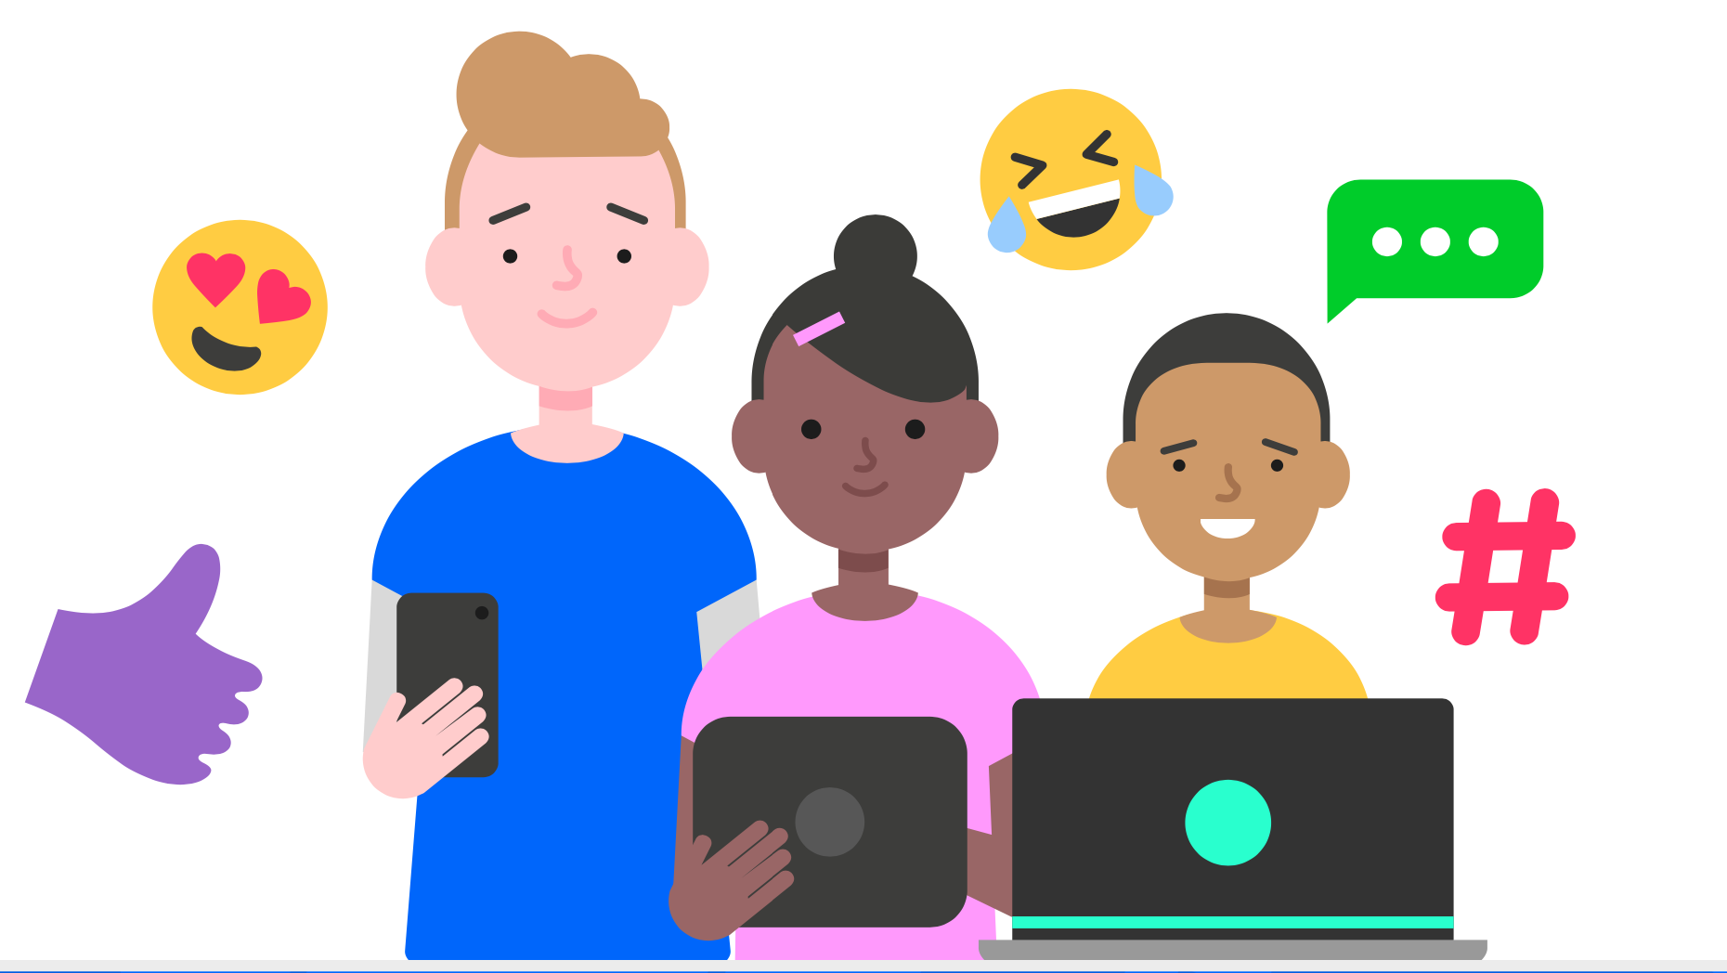
“My children know more about the internet than I do…”

Slide 4

Where can I find out more information?

Slide 5








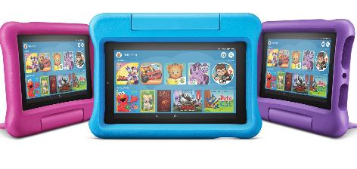
What social media, apps or games do your children use most?
Notes:
Ask the children to put their hands up.

Slide 6






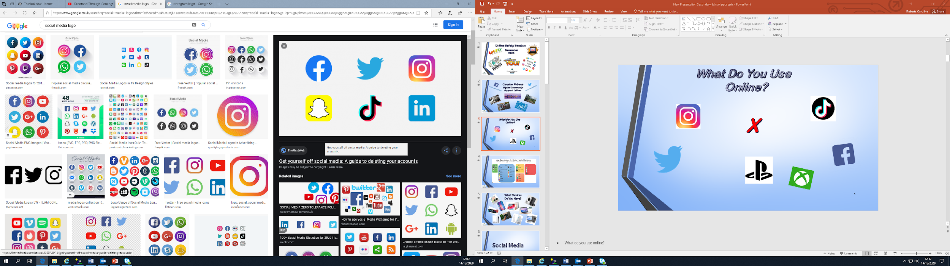




















Age Restrictions:
Instagram
YouTube
Among Us
Snap Chat
Minecraft
Roblox
Fortnite
Twitter
Facebook
Tik Tok
WhatsApp
Tumblr
Messenger
PlayStation
X-box
Twitch
Discord
Notes:
Here is some pictures to help give you a few ideas.
You might like to play games online, look at photos online that people in your family or your friends have shared, listen to your favourite music or you might like to search for some you favourite celebs.
Who would like to put up their hand and share what they like to do online?????
We are looking at information online, and whether we can trust everything that we read or see on the internet. Can you give me a hands up if you think that everything you see online is true, or a keep your hands down if you think that there might be some things online that aren’t true?
Lots you kept your hands down - that’s right (if applicable). Although there is lots of great information online that is useful and trustworthy, it’s important to remember that there is also information online that is not so trustworthy and may even been there to try and confuse us.
DO WE KNOW WHAT AGE YOU HAVE TO BE TO BE ABLE TO ACCSESS THESE??

Slide 7
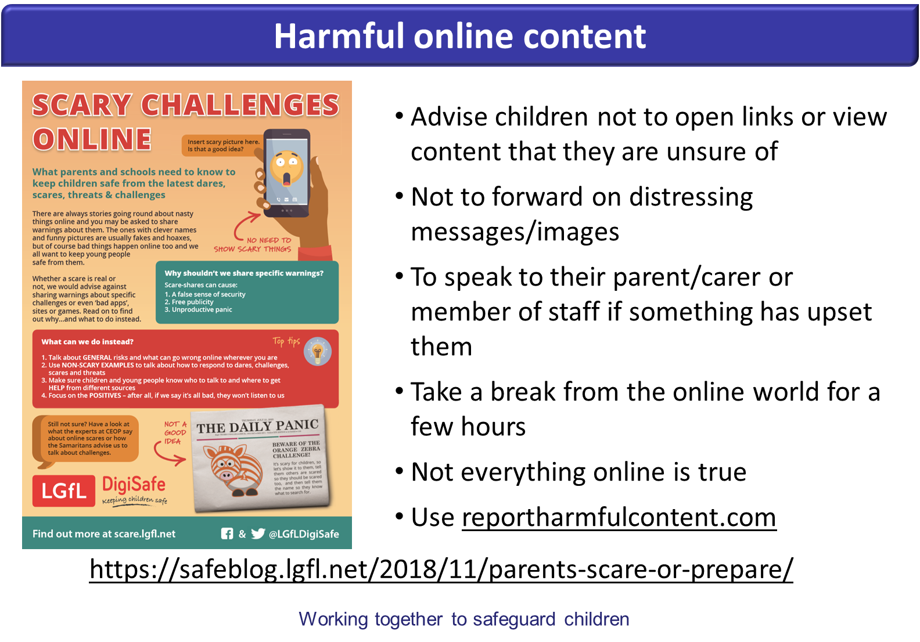

Slide 8


Slide 9
Facebook: How to report on Facebook
Instagram: How to report on Instagram
Google: Report inappropriate content
Roblox: Parent resources
Twitter: Report abusive behaviour
Snapchat: Report a safety concern

Slide 10
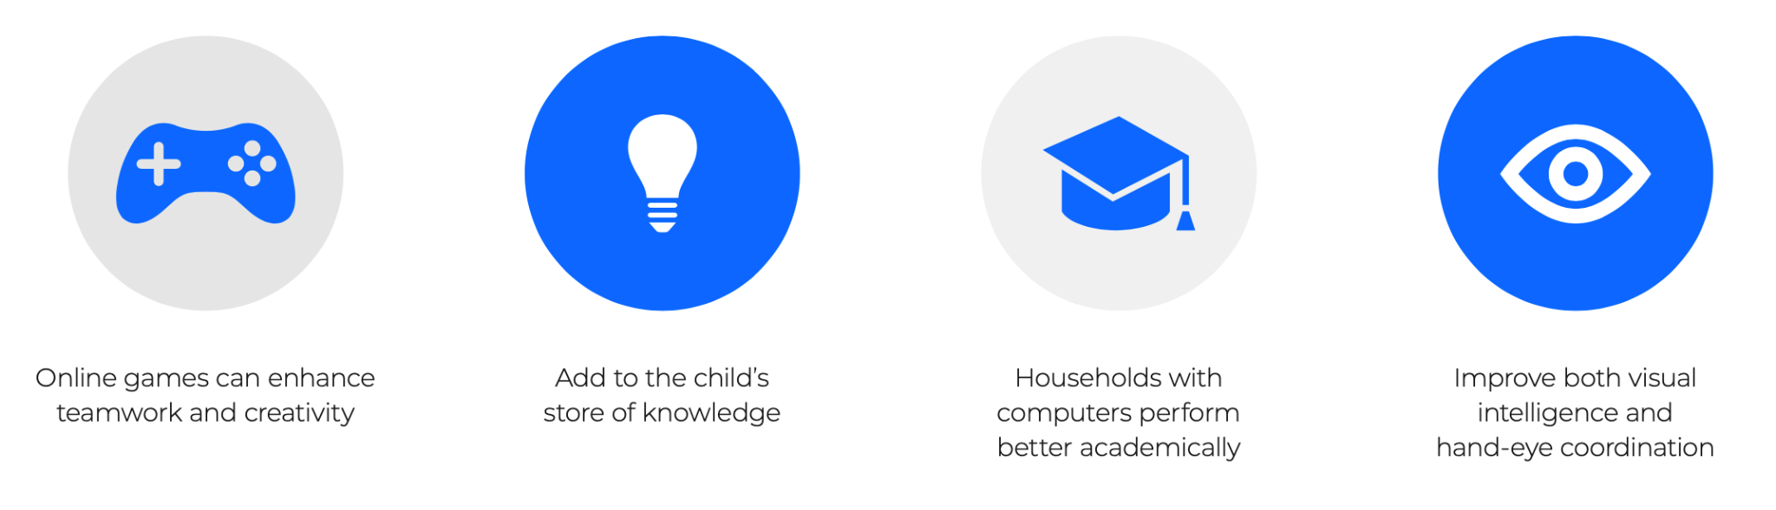
There are many positives to technology and the internet.
89% of 8-11 year olds said that using social media made them feel happy and 82% said it helped them to feel closer to their friends.
2020 Ofcom

Slide 11
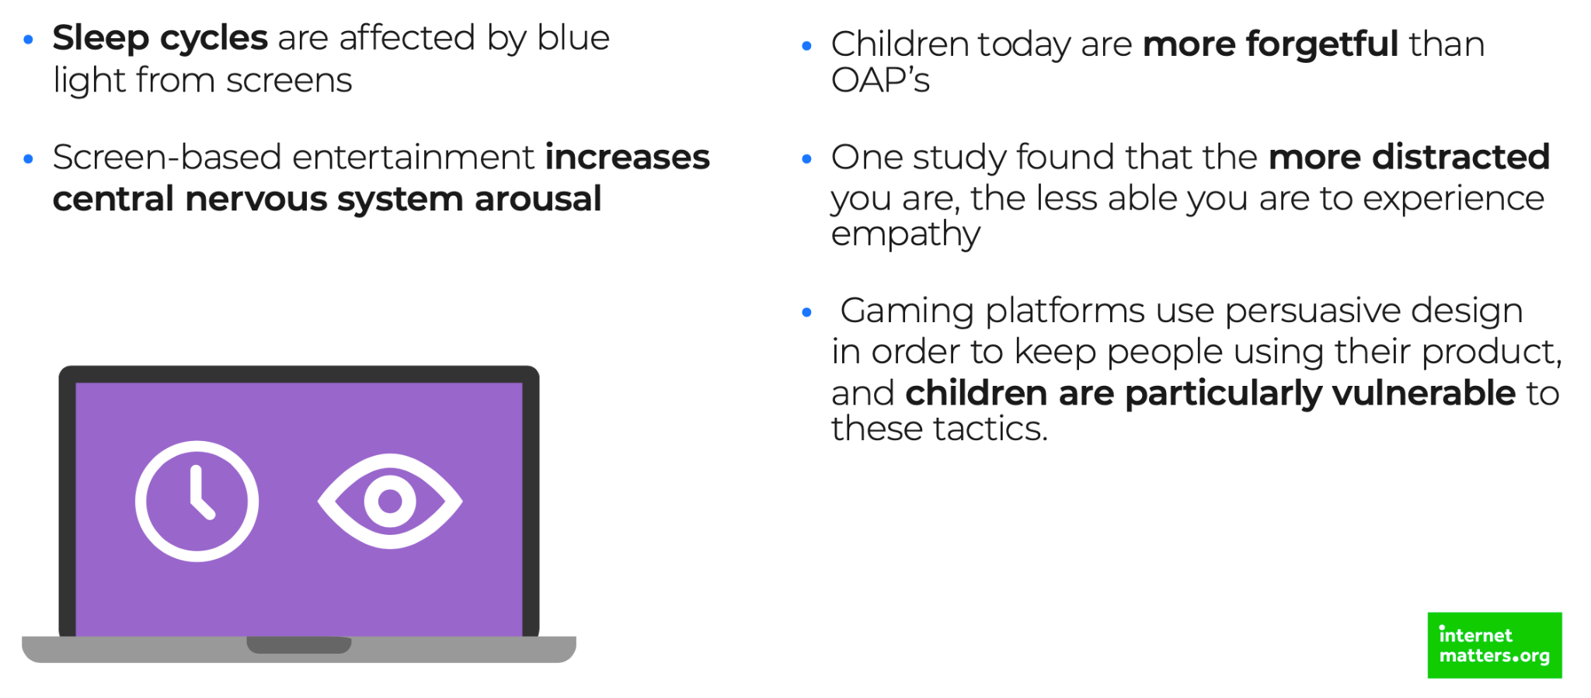
However, we know that it can also affect children’s development.

Slide 12
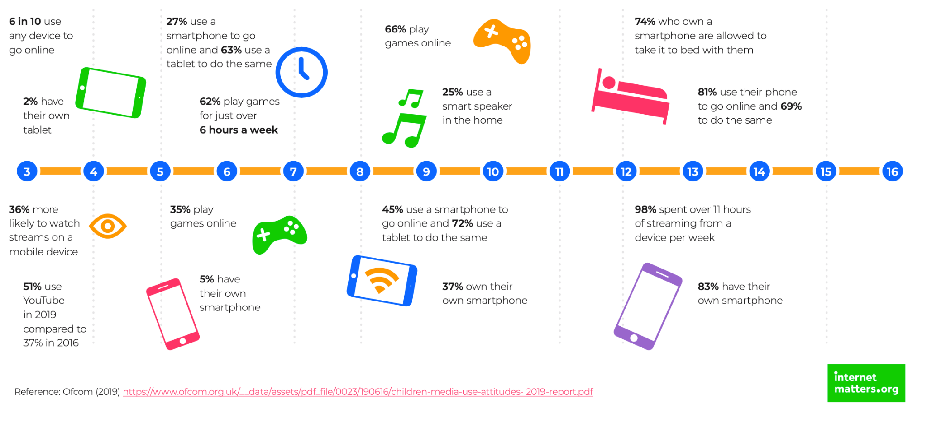
Media usage by age

Slide 13
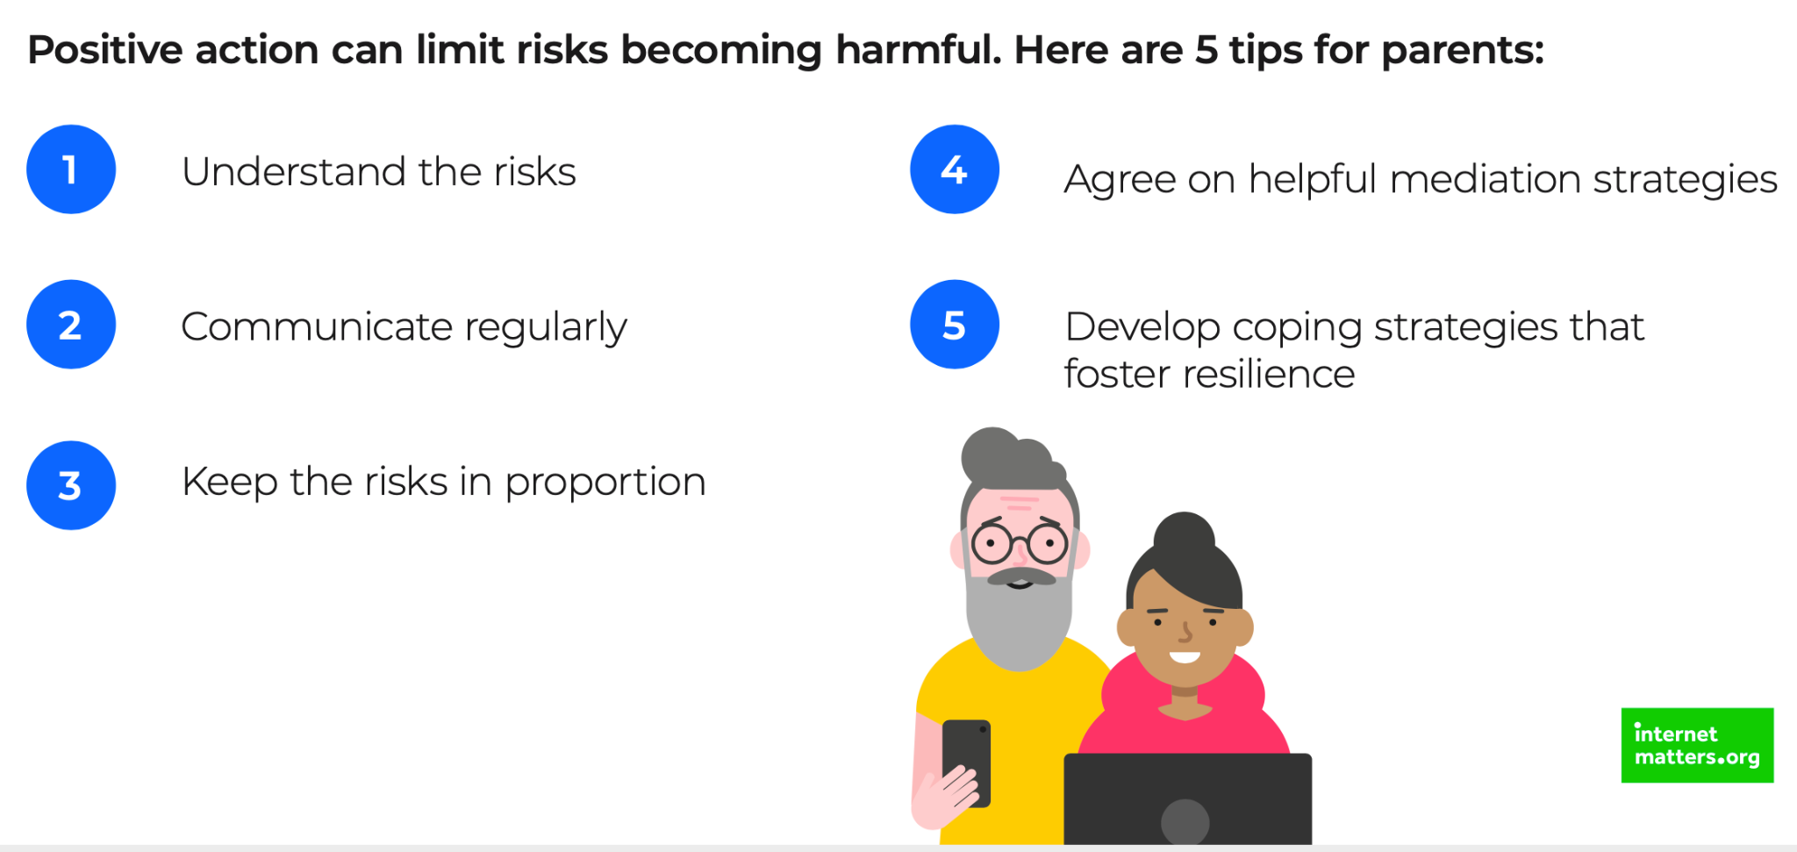
How we can monitor and help our children stay safe online

Slide 14

How we can monitor and help our children stay safe online

Slide 15
Questions to ask your child
Ask your children to tell you about the sites they like to visit and what they enjoy doing online.
Ask them about how they stay safe online. What tips do they have for you, and where did they learn them? What is OK and not OK to share?
Ask them if they know where to go for help, where to find the safety advice, privacy settings and how to report or block on the services they use.
Encourage them to help someone! Perhaps they can show you how to do something better online or they might have a friend who would benefit from their help and support.
Think about how you each use the internet. What more could you do to use the internet together? Are there activities that you could enjoy as a family?

Slide 16
What to talk about | Tools to support this
Sometimes people hide behind fake profiles for dishonest reasons Agree how they will respond to requests from people they don’t know in real life Never ever to meet up with anyone they don’t know in real life If something doesn’t feel right, tell someone | Set up safe social media profiles that don’t share personal information Turn off geolocation settings on devices Use the strongest privacy settings on social media Learn how to report/block/mute

Slide 17
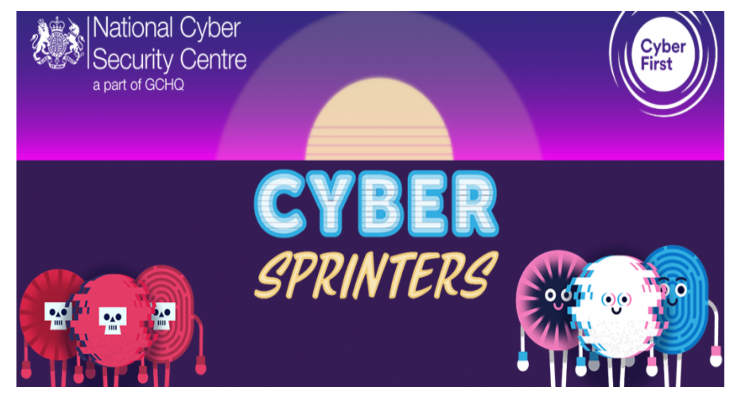
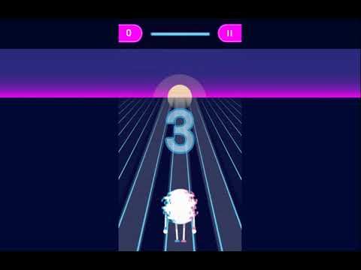
Making staying safe fun
CyberSprinters:
In the game, children play as a 'CyberSprinter', racing against their depleting battery to collect CyberSpheres and score points. They can boost their power by collecting padlocks and correctly answering a 50/50 question about staying cyber secure.
If they bump into a battery-sucking cyber villain, they play a mini-game (with a different internet lesson) to win back their stolen power. The main themes covered are:
creating and managing passwords
protecting accounts, devices and data
dealing with suspicious messages

Slide 18

How do we promote E-safety in school?

Slide 19
How do we promote E-safety in school?
Our Curriculum
PHSCE
Key Events and Visitors
Community Links
Our curriculum is developed to ensure that key skills are covered through a curriculum that builds skills, knowledge and understanding sequentially. We want pupils to be active, responsible participants in this future world, so we also understand the need to promote key e-safety messages and advice as a means to combat the risks that come from the pervasive nature of technology.
Our curriculum aims to develop the necessary knowledge for safe choices and informed decisions to be made so that pupils are well-prepared for later life. Pupils’ knowledge of British Values, issues pertaining to SMSC (spiritual, moral, social, and cultural development), wellbeing and essential safeguarding messages are all woven together into the curriculum
We cover a vast array of events and hold sessions with key visitors to promote and support internet safety.
Some of these include:
Internet Safety Day
Anti-bullying week
Community police officer links.
Bully Busters
These events are planned to support with the safer use of the online community and world.
We operate an open door policy to promote community links ensuring that parents and carers have ongoing support when dealing with e-safety.
Having a whole school approach helps ensure staff, governors, volunteers and parents teach children about online safety.
We encourage parents and carers to have open and honest conversations about the benefits and risks of the online world.

Slide 20


To ensure that we can promote the safe and secure use of search engines and access to the internet, in all classes we use ‘Kiddle’ as a search engine instead of Google.

Slide 21
What is expected of children’s use on the iPads

Slide 22
The primary use of iPads is for school work
Photographs and videos should not be taken unless told to do so by the class teacher or there is something relevant at home to show in school
iPads should be brought in everyday charged to a minimum of 70%
If children are given free time on their iPads at home, please monitor the usage

Slide 23
Any further questions or concerns?

